Slide 1

Living & learning at the race & gender intersection: Developing inclusive education with
Fashion Business Management students
Dr Julie Blanchard-Emmerson

Slide 2
Objectives of the research
To arrange 2 focus groups with MA Fashion Business Management students to co-construct knowledge about how to examine racialised minority representation in the fashion industry
To analyse data collected from focus groups to identify students’ issues of interest in relation to racialised minority representation
To examine collected data to enable the writing of teaching materials to facilitate good teaching and learning about racialised minority representation in the fashion industry.

Slide 3
Fashion and Race
Unit: Fashion Theories & Histories
Dr Julie Blanchard-Emmerson
Fig 1: From Vogue UK fashion shoot, ‘Indian Summer’, September 2007. Model Gemma Ward. Photographer Patrick Demarchelier. As discussed in Cheang (2013).
Notes:
Vogue
Race and gender are intertwined – both in terms of representations/constructions of white women as the consumer of fashion, and the quaint traditionally dressed Asian woman who is associated with the production of fashion, the worker who is paid so little.
As Dyer argues, “racial imagery is central to the organisation of the modern world” (Dyer, 2017: 1).

Slide 4
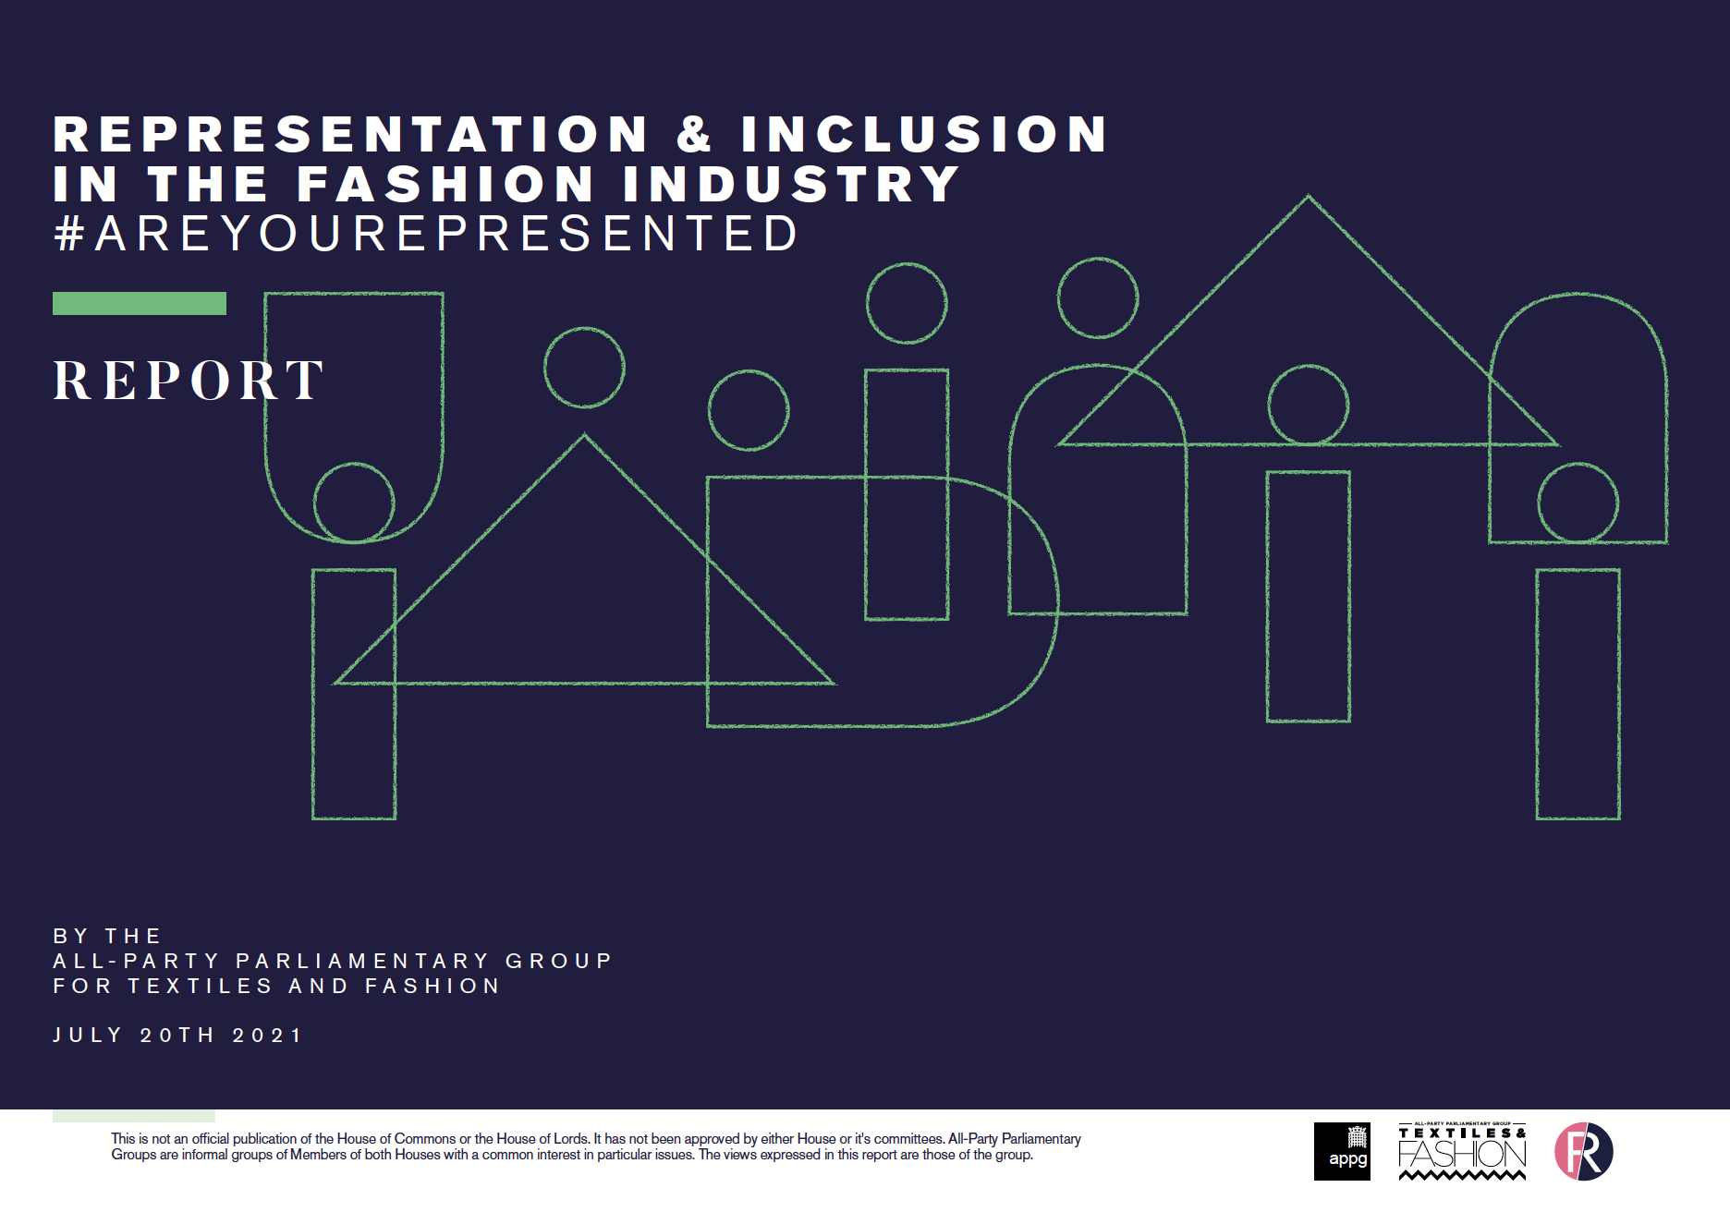
Notes:
The British Fashion Council’s (2022) research shows that ethnic diversity is very poor in the fashion industry, particularly in senior roles, with many businesses having solely white people on their Boards and executive committees (British Fashion Council, 2022, p. 10).
There is also an intersection of social identity factors that result in exclusion from key roles, with under-representation also of women, people with a disability and those from a socially deprived backgrounds (British Fashion Council, 2022, p. 10; Textiles & Fashion APPG, 2021)

Slide 5
Carrying out the research
Focus groups as method:
  With minimal intervention from the researcher (Gibbs, 1997), participants raise the topics of most relevance to them, generating their own questions and concepts on their own terms (Barbour & Kitzenger, 1999, p. 5).
Two focus groups are adequate to reveal key themes and ideas for analysis (Guest et al. 2016).
Focus group 1: 1 Nigerian and 2 Indian female participants
Focus group 2: 1 Bangladeshi male and 4 Nigerian female participants
Notes:
Pilot study?
All given pseudonyms

Slide 6
Findings so far
Strategies suggested by participants relating to the classroom:
  continue decolonising the curriculum (fits with current thinking, see Moghli & Kadiwal 2021)
  students to also explore each other's cultures themselves (as Currie 2007 found to be useful)
  importance of cross-cultural communication - ensuring mixed cultural groups in seminars (again Currie 2007 shows this can work).
Notes:
“while you are studying here, it’s a good that you talk about things that belong to other countries or other regions, that kind of inclusivity is very interesting “ FG1
Anika said, “if I’m Indian and the other group is Korean, maybe I would do what they come from and they would do what I come from, so then it would be more insightful…they are eventually respecting what you do, but you’re also respecting their own country now.”
Myra “I think everybody in the class, everybody in the university, tried to split up from where they come from and tried to know each other more, try to learn a few words from their language and start communicating”

Slide 7
Findings so far
Strategies suggested by participants for outside of the classroom:
  value of field trips and social activities (Avolio et al. 2019 support this notion)
  significance of food culture; an international menu in the canteen could increase student sense of belonging (as Buell et al. 2021 note).
Notes:
Trips – they have never experienced certain places, spaces, objects. Mercy FG2 “a person maybe just through reading the books, they will understand quickly. Me, I understand more when I see and I touch, then I understand”
Halima explained “it’s not about the taste..it’s about the acknowledgement that we are part of this school”.

Slide 8
Findings so far
Other wider issues raised in participant discussion:
    finding decent housing (Ike et al. 2020 show that students in settled housing have better educational outcomes)
    as international students, the intersection of race and nationality, was key to their identities (Johnson et al 2019 refer to the multiple social factors shaping students’ identities)
    acculturation (Lim et al. 2021).
Notes:
“you’re looking for a house and somebody asks you, “Where are you from?” Does it matter? I can afford to pay, I can keep your place, I am not going to mess up your home, so why don’t you give me a chance to prove myself, other than, “Oh, she’s Black, oh, she’s Asian”
Adeola FG1: “You are African.” Africa is a large continent, come on, we have millions of different groups, we have people, up North Africa, we have people that are close to Caucasian, we have people that are Black, we have real Negroes. When you tell me I’m African, you are putting me in a box, so which part of Africa? So why don’t you just, like, “Oh, where are you from?” “I’m Nigerian ”
Jennifer: I still try to just restrict myself from “You are in the UK, behave like one of them.” (Laughter). But really, I, we should be respectful, you are a lecturer, you are an elderly person, normally we should be, like, “Good morning, ma. How are you today, ma?” I’m supposed to call you by your name? What?! You call your lecturers by their name?! We are dead!

Slide 9
Tentative conclusions
Student identities are a complex intersection of their gender, race, nationality, and language, amongst other factors
All these aspects impact on their experiences at university and in the wider world
We must attend to the factors within our control such as the curriculum and group work
But we must also campaign to ensure that our institutions go beyond the classroom to support our students.

Slide 10
Bibliography
Advance HE (2020) Use of language: race and ethnicity. Available at: https://www.advance-he.ac.uk/guidance/equality-diversity-and-inclusion/using-data-and-evidence/use-of-language-race-ethnicity (Accessed: 5 April 2022).
Barbour, R. S. & Kitzenger, J. (1999) Developing Focus Group Research: Politics, Theory and Practice. London: Sage.
​British Fashion Council & MBS Group (2022) Diversity and Inclusion in the Fashion Industry. London: The MBS Group.
Buell, K. J., Briscoe, K. and Yao, C. W. (2021) '"It Just Doesn't Taste the Same": International Students' Perceptions of On-Campus Food and Dining’, in The journal of college and university student housing, 47 (2) p.10-23.
Cheang, S. (2013) ‘”To the Ends of the Earth”: Fashion and ethnicity in The Vogue Fashion shoot’, in D. Bartlett, S. Cole and A. Rocamora (eds) Fashion Media: Past and Present. London: Berg
Dylan, A. (2012) ‘Safety in the Classroom: Safeguarding Liberal Arts Education from the Neo-Liberal Threat’, Canadian Journal of Higher Education, 42(2), pp. 34-48.
Dyer, R. (2017) White: Twentieth Anniversary Edition. London: Taylor and Francis. 2nd edition.
Gibbs, A. (1997) ‘Focus Groups’, Social Research Update, Winter(19).
Guest, G., Namey, E. & McKenna, K. (2016) ‘How Many Focus Groups Are Enough? Building an Evidence Base for Nonprobability Sample Sizes’, Field Methods, 29(1), pp. 3-22.

Slide 11
Ike, N., Baldwin, C., & Lathouras, A. (2020) ‘Tertiary students’ housing priorities: Finding home away from home’, Canadian Journal of Urban Research, 29(1), pp. 55–69. https://www.jstor.org/stable/26929897
Johnson, P., Houston, B. & Kraglund-Gauthier, W. (2019) ‘Decolonizing the classroom in social justice learning: Perspectives on access and inclusion for participants living with disabilities’, in J. Hoffman (ed) Strategies for Fostering Inclusive Classrooms in Higher Education : International Perspectives on Equity and Inclusion. Bingley: Emerald Publishing Ltd, pp. 83-95.
Lim, J.H., Wang, Y., Wu, T., Li, Z. and Sun, T. (2021) 'Walking on Gender Tightrope With Multiple Marginalities: Asian International Female Students in STEM Graduate Programs', Journal of International Students, 11(3), pp. 647-665.
Moghli, M. A. & Kadiwai, L. (2021) ‘Decolonising the curriculum beyond the surge: Conceptualisation, positionality and conduct’, London Review of Education, 19(1), pp. 1-16.
Sengupta, E., Blessinger, P., Hoffman, J. & Makhanya, M. (2019) ‘Introduction to Strategies for Fostering Inclusive Classrooms in Higher Education’, in J. Hoffman, P. Blessinger & M. Makhanya (Eds) Strategies for Fostering Inclusive Classrooms in Higher Education : International Perspectives on Equity and Inclusion. Bingley: Emerald Publishing Ltd, pp. 3-17.
​Textiles & Fashion All Parliamentary Party Group (2021) Representation & Inclusion in the Fashion Industry, s.l.: Fashion Roundtable.
Williams, J. J. (2013) ‘The teachings of student debt’ in Heller, D, & Callender, C (eds) Student Financing of Higher Education : A Comparative Perspective, Taylor & Francis Group, Oxford

