Slide 1
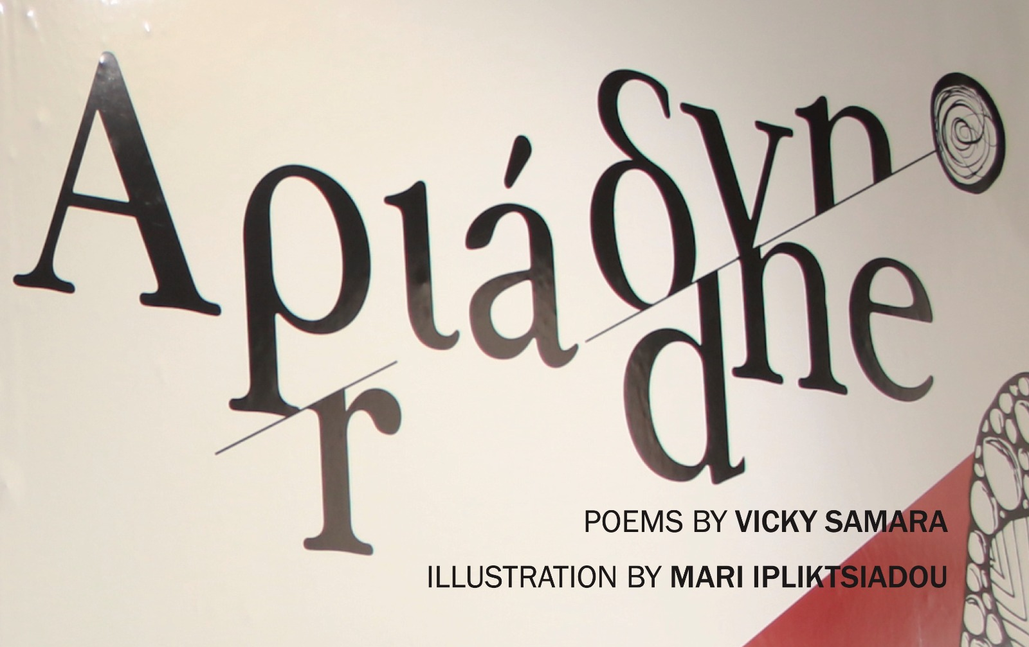

CURATED BY LOUCIA MANOPOULOU
Text/Techne: A Curatorial Approach to Explore an Auto Biographical Poetic Collection as an Aesthetic Experience
Dr Loucia Manopoulou, Curator, Researcher
Dr Vicky Samara, Poet, Scientist

Slide 2
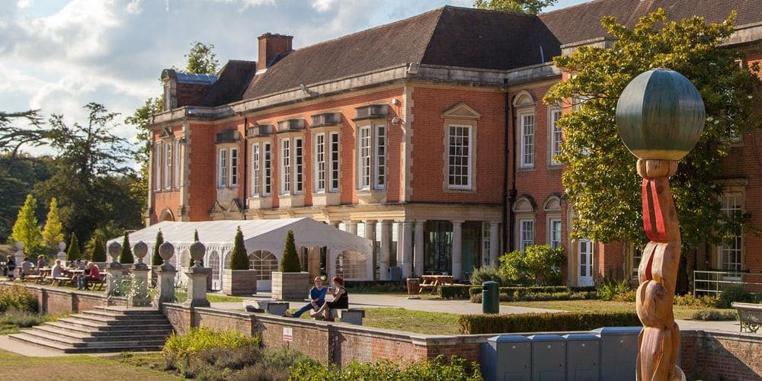
South Hill Park, Arts Centre Bracknell.
A historic English House, Victorian Mansion that was converted to thriving art centre in 1973.
Southhillpark.org.uk

Slide 3


Slide 4
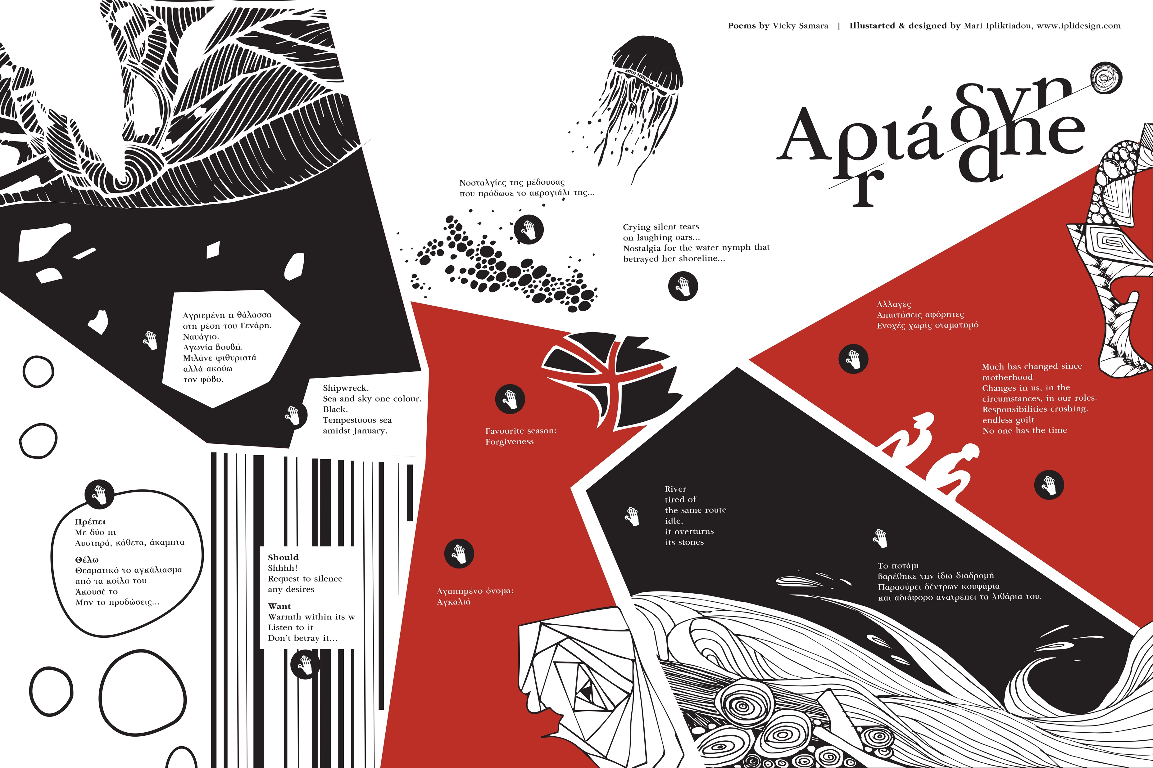

Slide 5
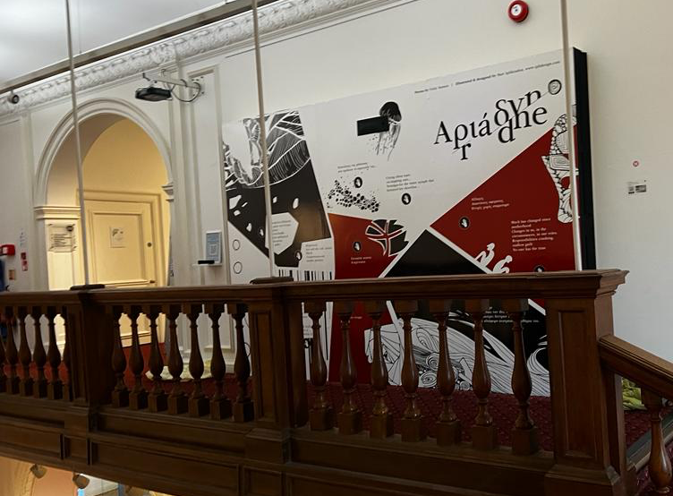

Slide 6
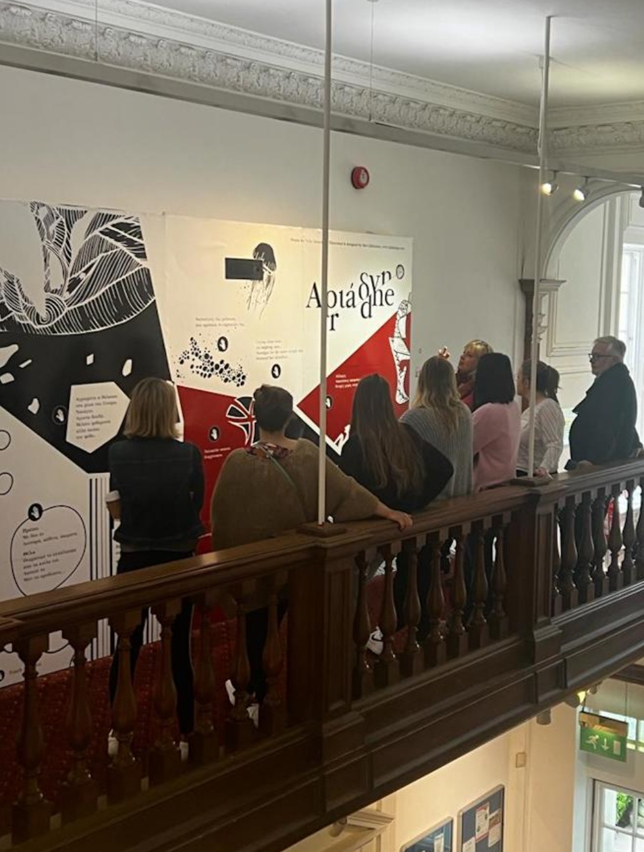

Slide 7
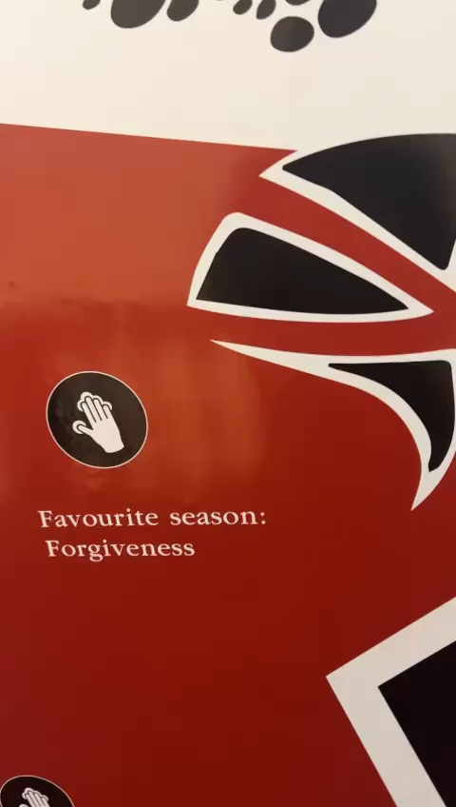

Slide 8
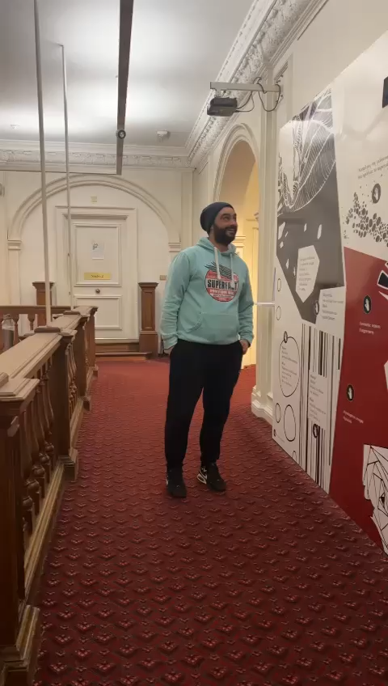

Slide 9
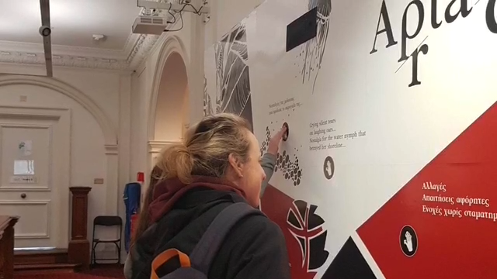

Slide 10
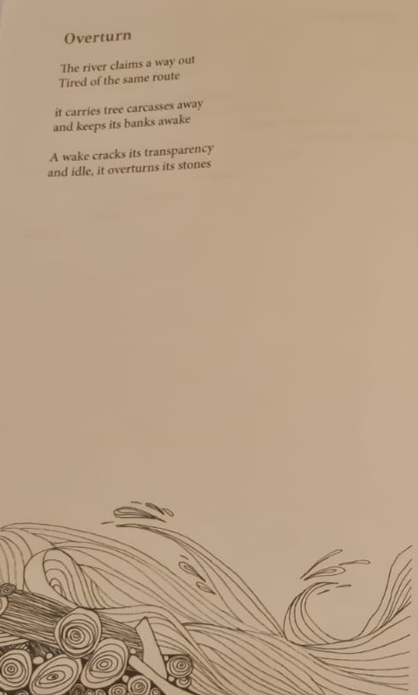
Thank you!
Dr Loucia Manopoulou
Dr Vicky Samara

