Slide 1
LEARNING TO LEARN
SEAMLESSLY

Slide 2
DSA funding cuts in support hours
Notes:
- Figures above are collective (DSA and UCA funding)
- DSA changes to make disabled students more independent whilst at university
- Funding changes designed to make institutions provide more funding and support for disabled students
http://reach.ac.uk/disabled-student-allowance-dsas-changes-201617-a-simplified-guide/

Slide 3
Project Aims
Identify common challenges students encounter
Present leaners with a range of approaches to learning
Support this by giving learners a toolkit
Through activity learning, develop new skills and
confidence with personalised learning
Notes:
The project was geared around providing support and a vehicle for independent learning

Slide 4

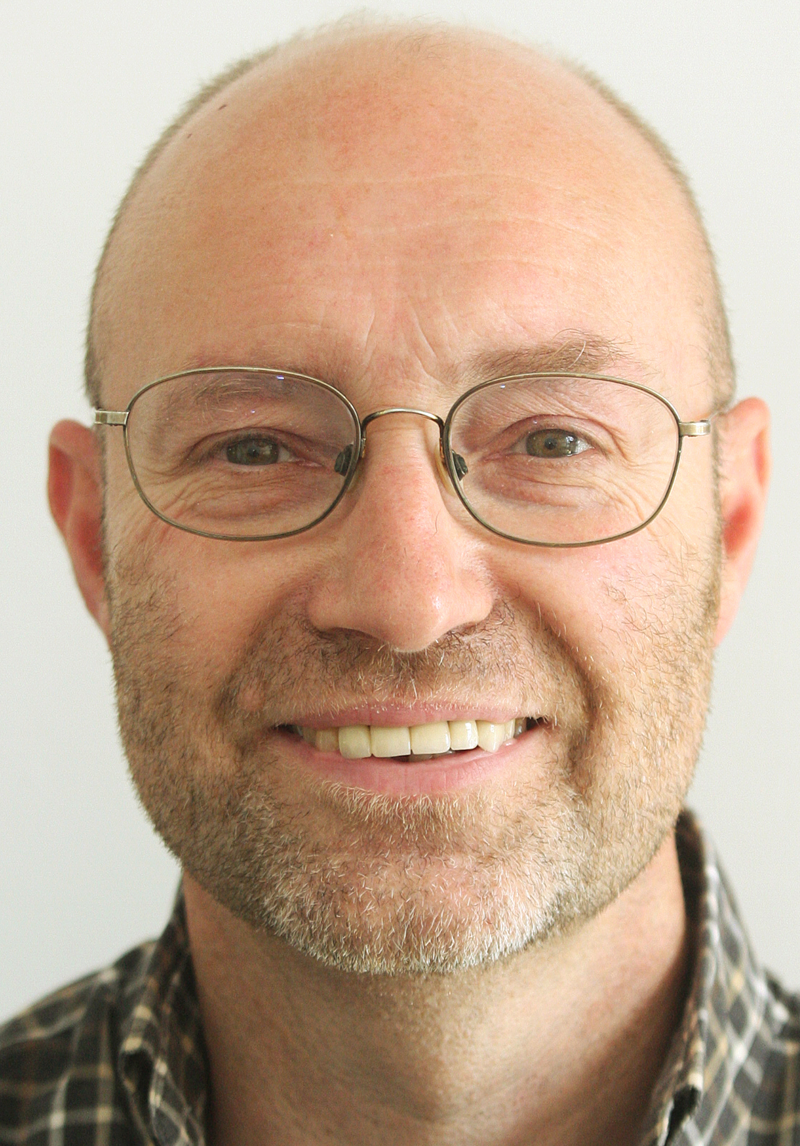
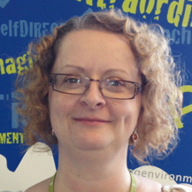

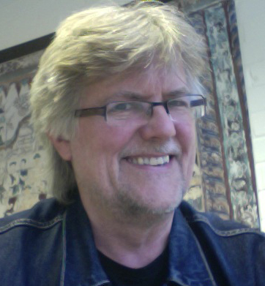
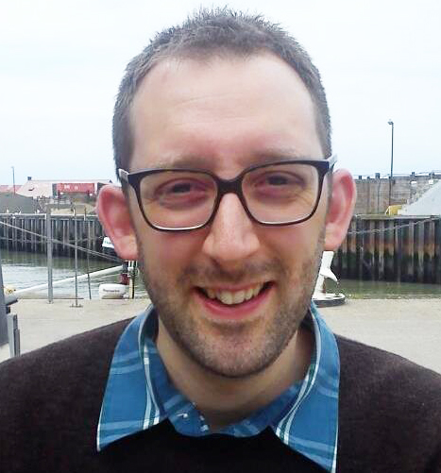




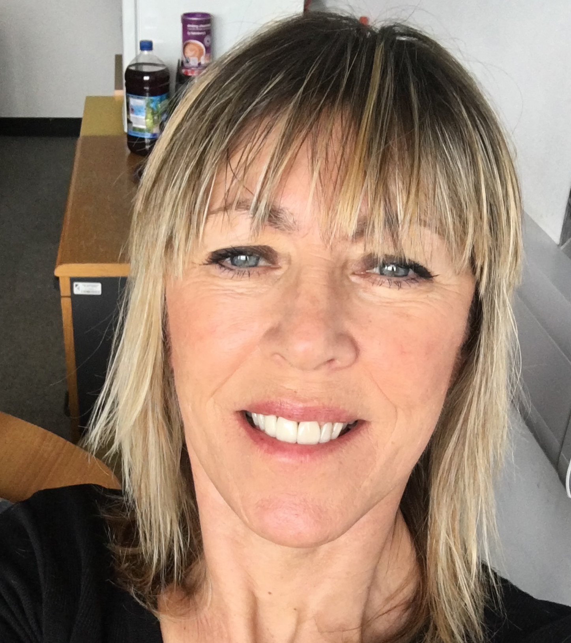


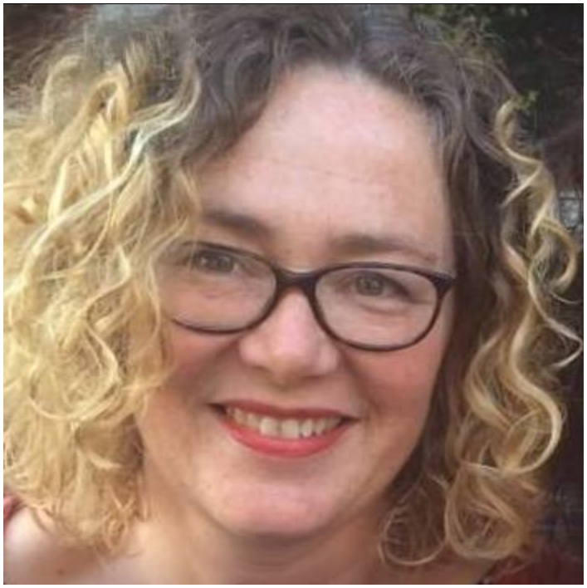
Project Team
Learning & Teaching Librarians
Study Development Tutors
Learning Enhancement & Support
Learning Technologists
Faculty Technician
Quality Assurance & Enhancement
Student Focus Groups
Design Students
Notes:
May 2016 - Project developed as a result of the change in DSS funding
Toolkit was developed to equip students to seek independent help
Overall Funding – 8k
Spent mainly on paying staff/student hours plus focus groups

Slide 5
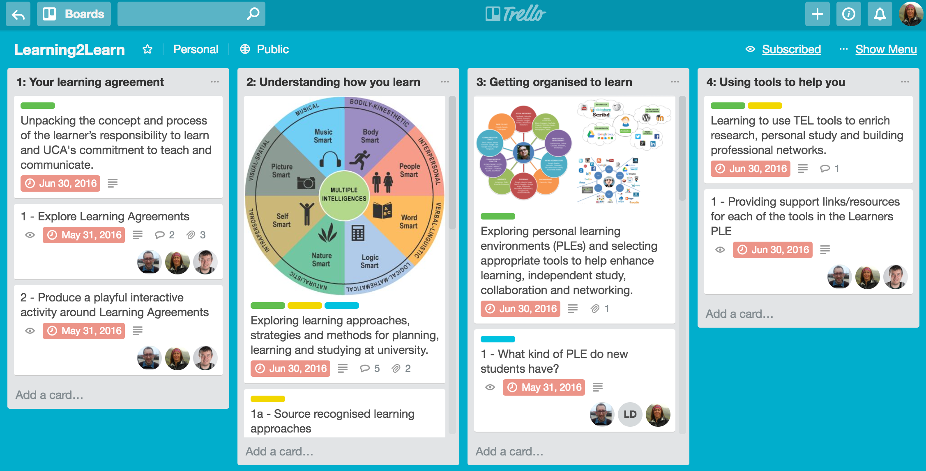
Project Management Tool
Learning & Teaching Librarians
Study Development Tutors
Learning Enhancement & Support
Learning Technologists
Faculty Technician
Quality Assurance & Enhancement
Student Focus Groups
Design Students
Notes:
https://trello.com/b/jlsfFowh/learning2learn

Slide 6
Project Resources

Slide 7
Project Resources

Slide 8
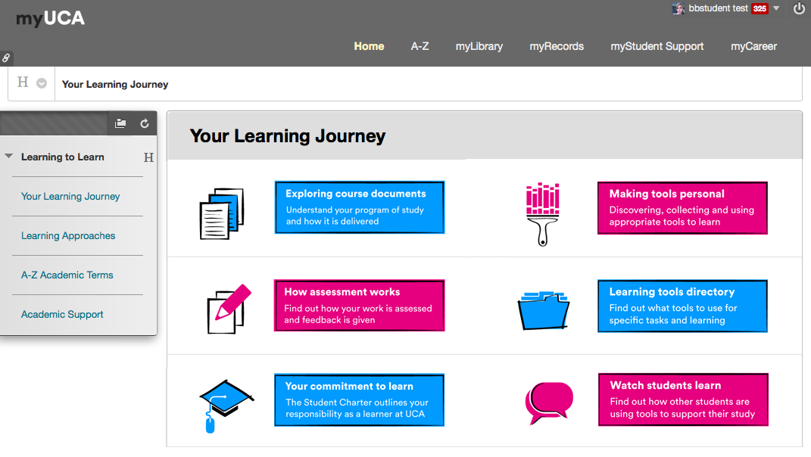

Slide 9
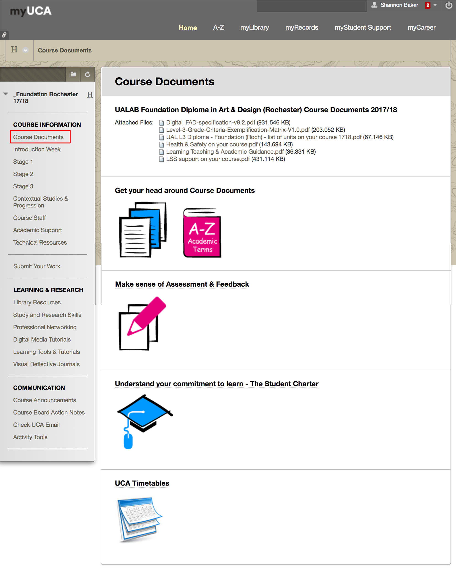

Slide 10
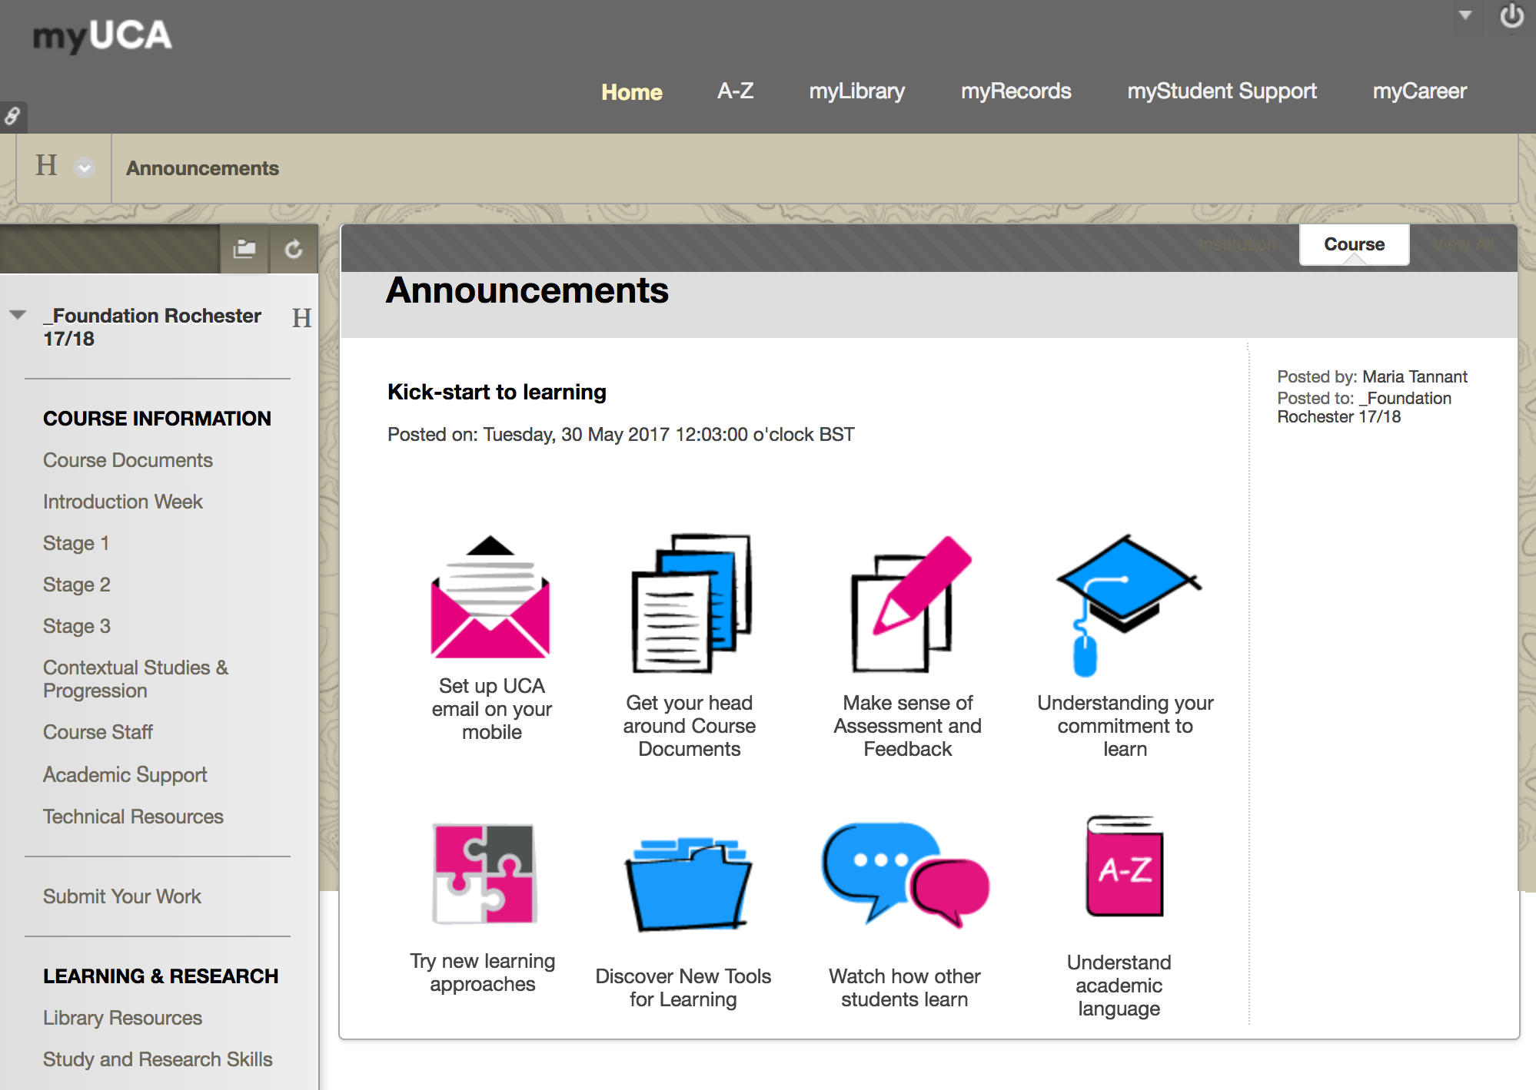

Slide 11
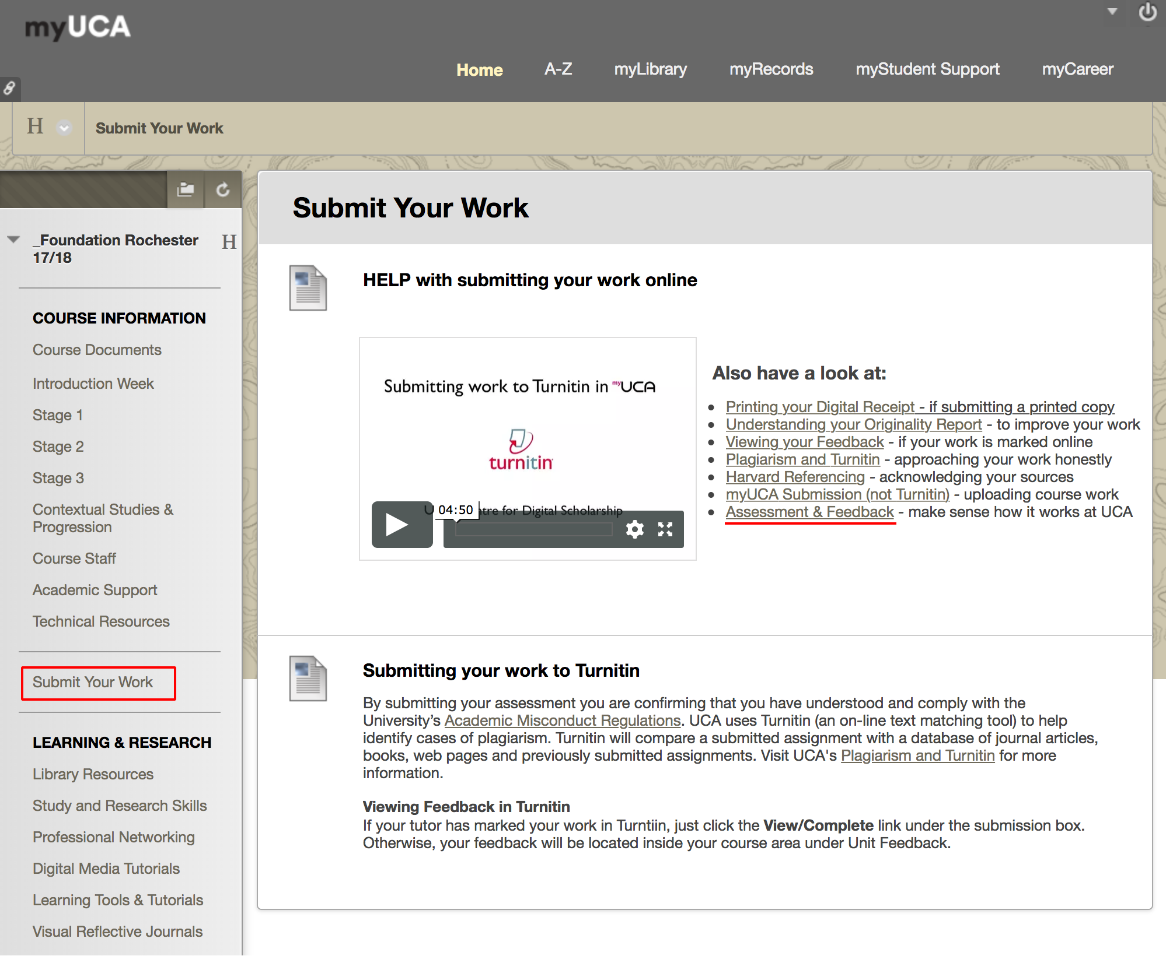

Slide 12
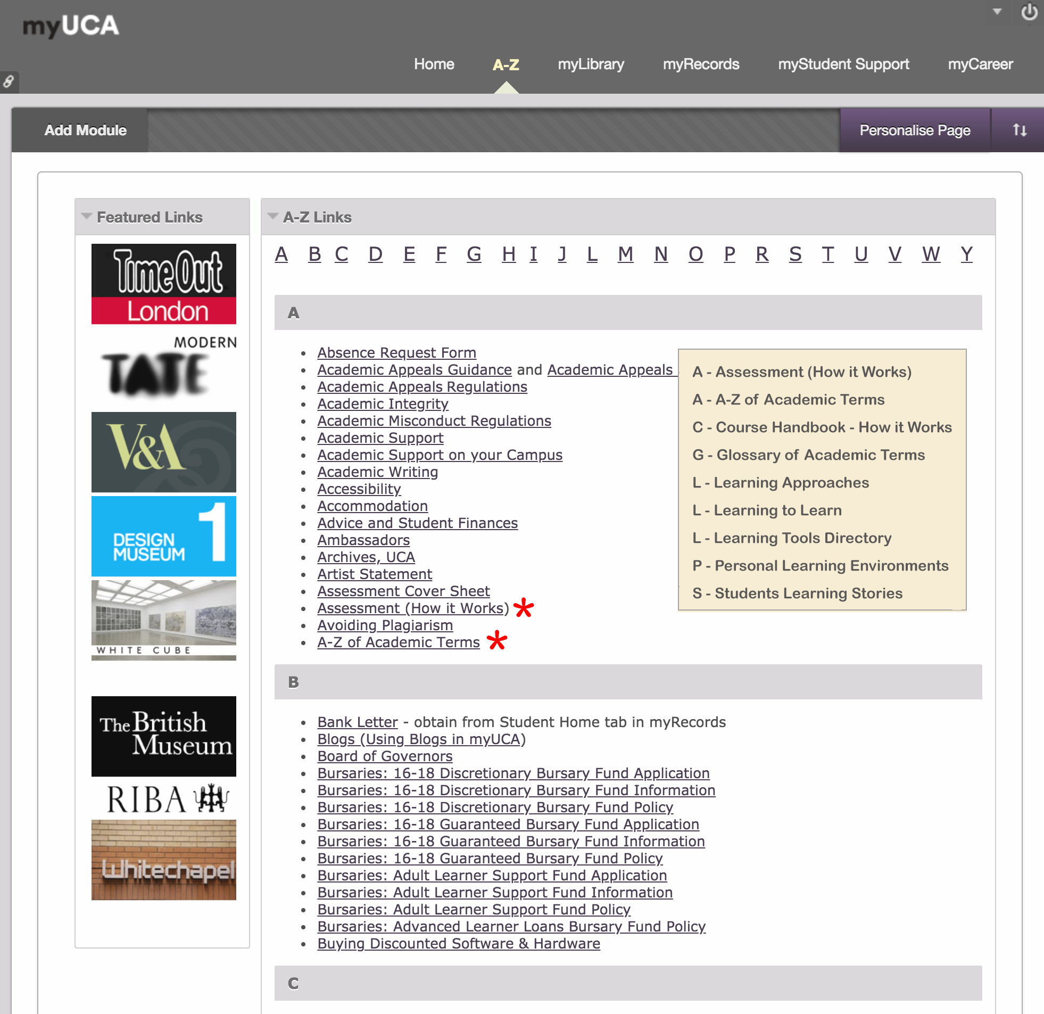

Slide 13
Project Outcomes
PROVIDING - point-of-need learning
LOCATING - learning materials in situ
ADVOCATING - self-directed and independent learning
ADDRESSING - challenges students face when entering HE
Notes:
Having done the project, the Learning Technologists were in a prime position to be able to embed the tools at the point when they need them most.
Students where not just going to the main Learning to Learn resource, so there was a danger of all these resources going to waste not getting used.

Slide 14

Benefits for students
Easy to Find
Easy to Understand
Active Experiential Learning
Demystifies Assessment
Self-Paced
“Discovering how various tools can help me learn and manage my student life”
Notes:
Online tools for students when and where they need them, will explore - Learn2Learn, looking at the project, its outcomes, reflections and future plans and how it integrates within course and unit areas in myUCA.

Slide 15
Benefits for UCA
Point of Need
Embedded and in Context
Visible to Course Teams
Transparent & Aligned
Centralised Support
“Equipping students with tools to learn at their own pace”

Slide 16
Lessons Learned
Course team endorsement
Support teams need buy-in
Devolve responsibility and allocate ownership
Involve QAE (Quality Assurance & Enhancement)
Review - update - review
“Discovering how various tools can help me learn and manage my student life”

Slide 17
GET IN TOUCH…
MARIA TANNANT
University for the Creative Arts
mtannant@uca.ac.uk

