Slide 1
Bridging a gap with a window:
interactive screencasts for transparent assessment practices

Slide 2
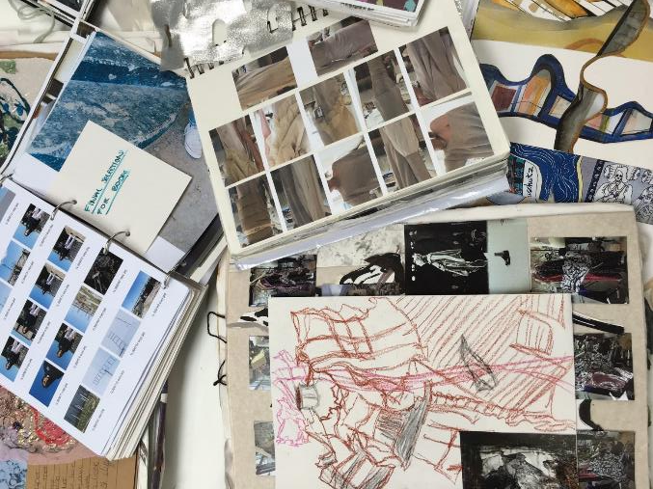
The Gap: lecturer and student understandings of sketchbook assessment
Lea and Street (1998) found interpretation of terms assessment criteria varied greatly within and between courses and disciplines

Slide 3
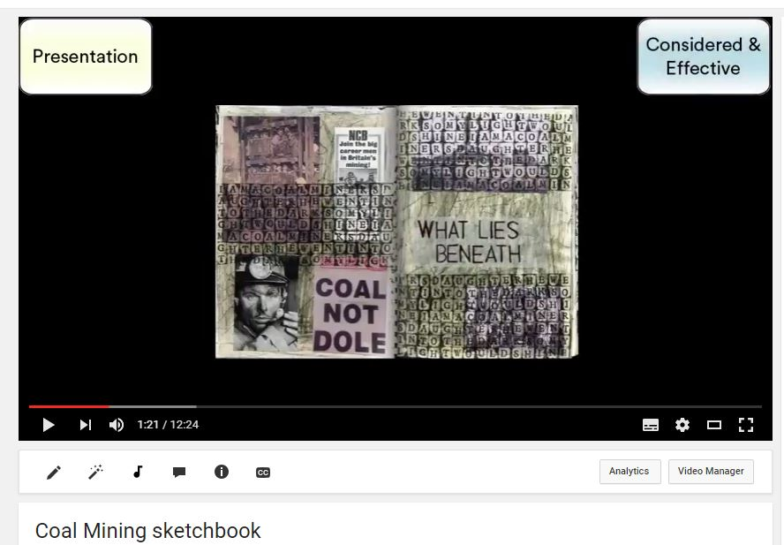
The window: screencasts to engage students in assessment process

Slide 4
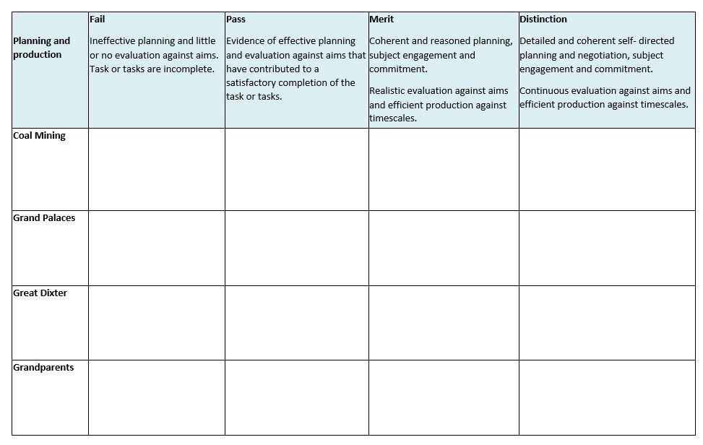
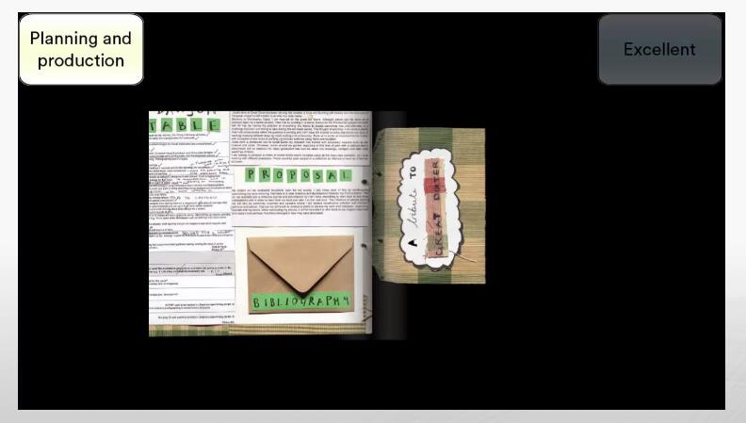
Guided peer assessment task

Slide 5
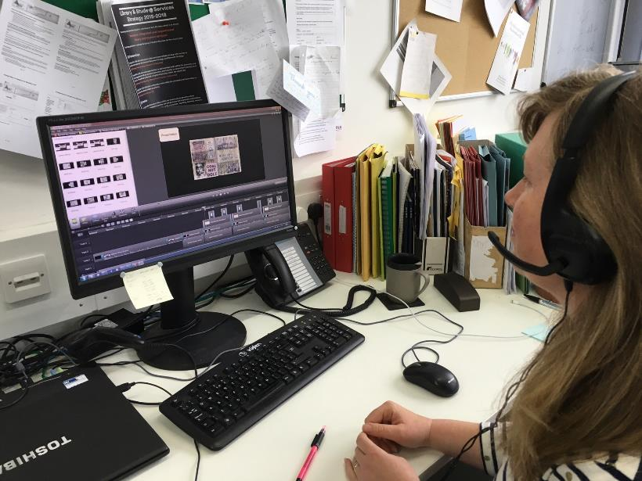
resource development

Slide 6
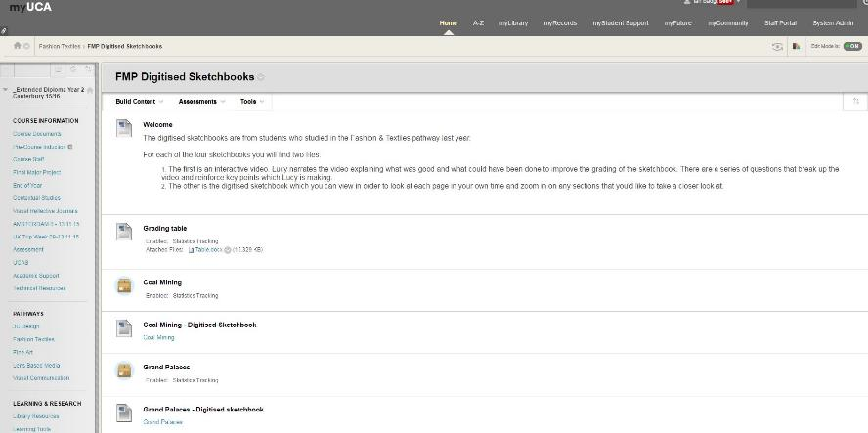
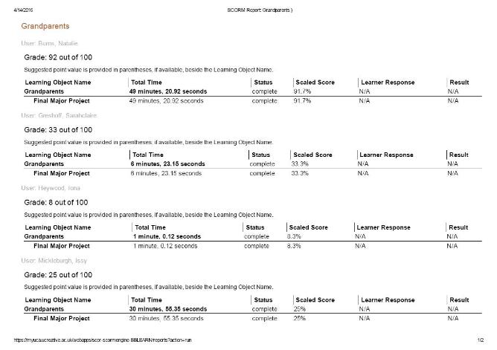
Promotion & analytics

Slide 7
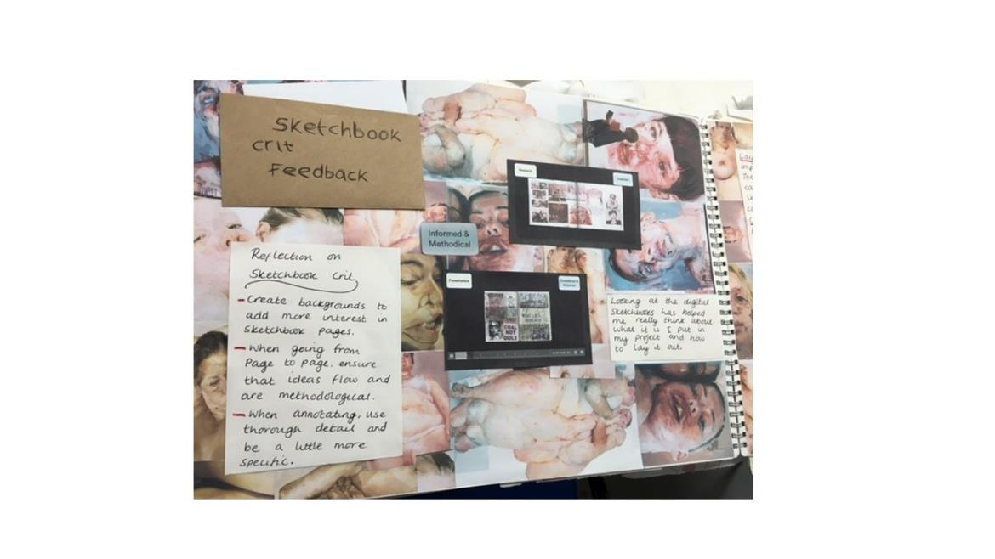
Student feedback

Slide 8
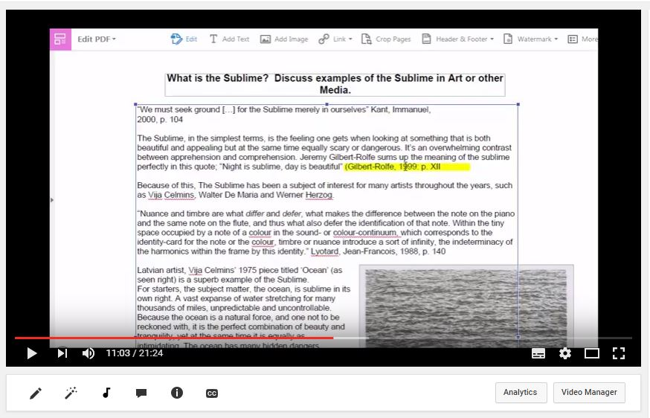
Application to different learning contexts

Slide 9
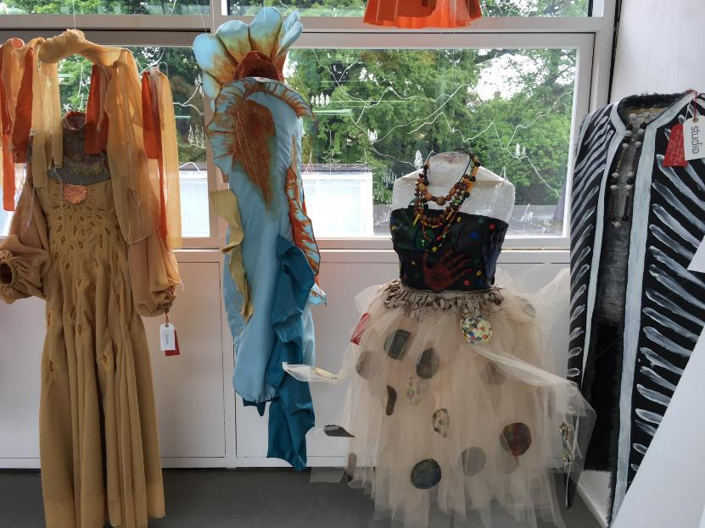
Reflections on the window: a metaphor too far?

Slide 10
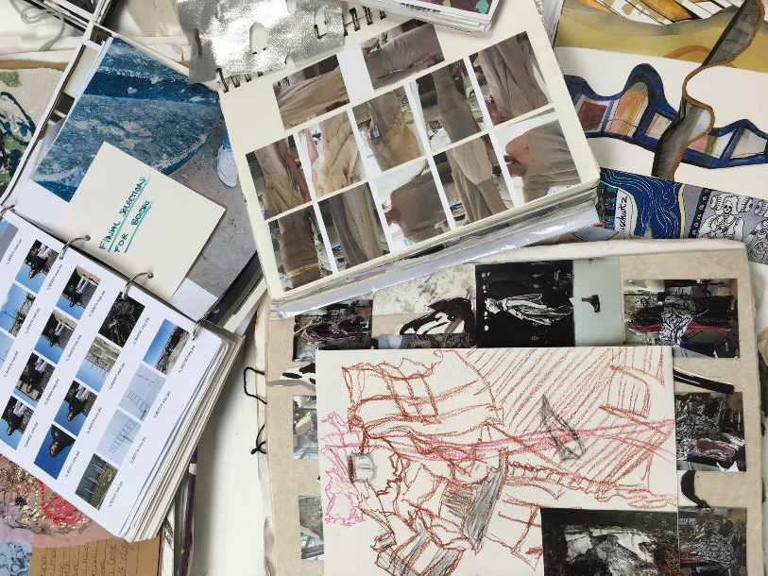
Any questions

