Slide 1
Describing and developing terminology
For multiple identity collections
Rebekah Taylor, Archivist & Special Collections Officer
Notes:
Introduce you to a work in progress. This project involves research into how we describe our LGBTQ collections, specifically LGBTQ collections involving multiple identities. This includes looking at search terms, uncontrolled and controlled vocabulary, and looking at the feasibility of adapting a controlled vocabulary, and/or creating our own, to Improve the catalogue’s searchability. Definiton of controlled vocabulary? Negatives on controlled vocab – generally not specific enough for archives, written with published books in mind, positives of controlled vocab – helps with consistency? A controlled vocabulary is an organized arrangement of words and phrases used to index content and/or to retrieve content through browsing or searching. It typically includes preferred and variant terms and has a defined scope or describes a specific domain.
This has involved undertaking a pilot on search terms with a sample of our collections, which has involved some of our staff and students at the university. I should note while our collections have mixed formats – personal library collection and archival material – I am focusing on archives in this instance. We have also done a call out to wider communities to be involved, and have been working with creators, people . So why does this matter/why do they I want to do this? Our collections do not just look at sexuality on its own – they link sexuality towards class, gender, race, disability – for example working class lesbians may have different experiences to middle class – if there aren’t suitable vocabulary to describe marginalised groups, then material that is actually there in the archive, may not be discovered
Aims of this project involve, engaging multiple voices and communities with our collection, seeing if we can adapt a controlled vocab (to be in line with the library catalogue), and seeing from the suggested terminologies/search terms given from different communities whether we can also create/utilise a more specific vocab of our own.

Slide 2
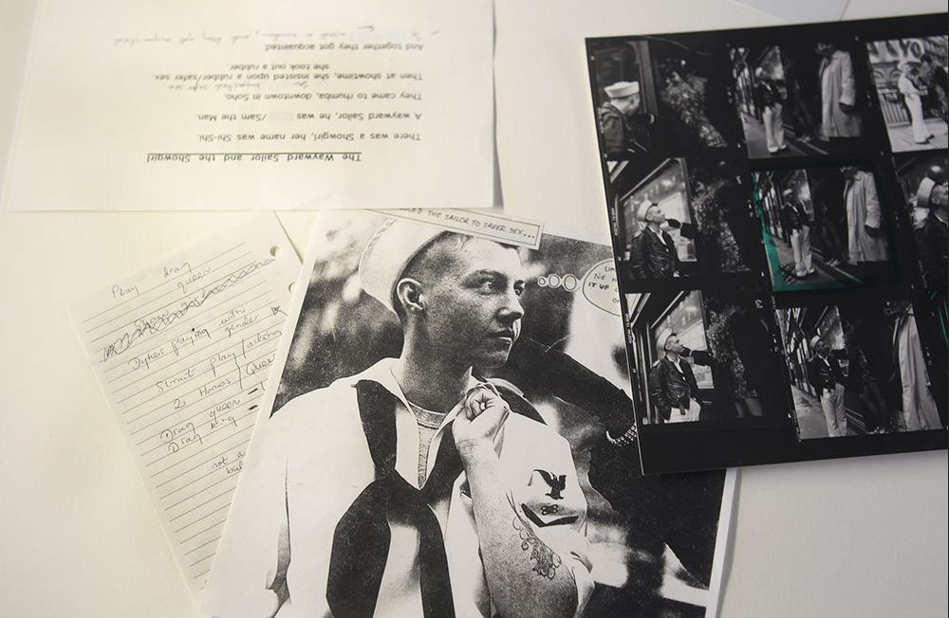
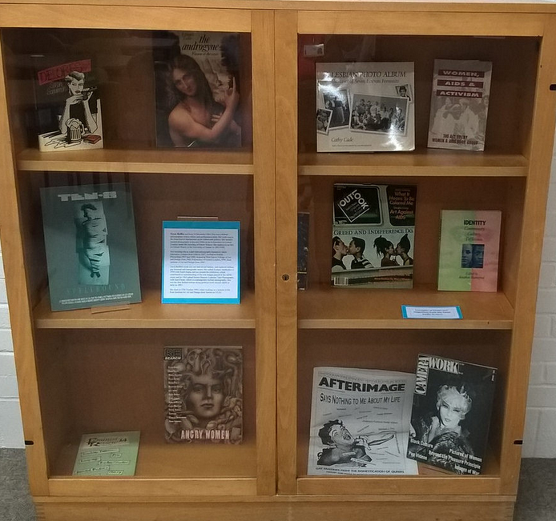
Notes:
Here are collections that include intersectionalities.(2 mins) – Tessa Boffin

Slide 3
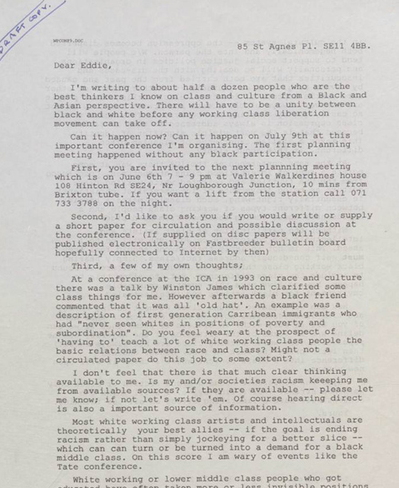
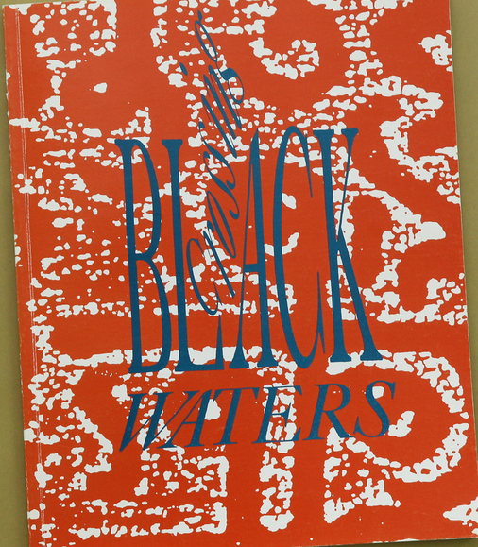
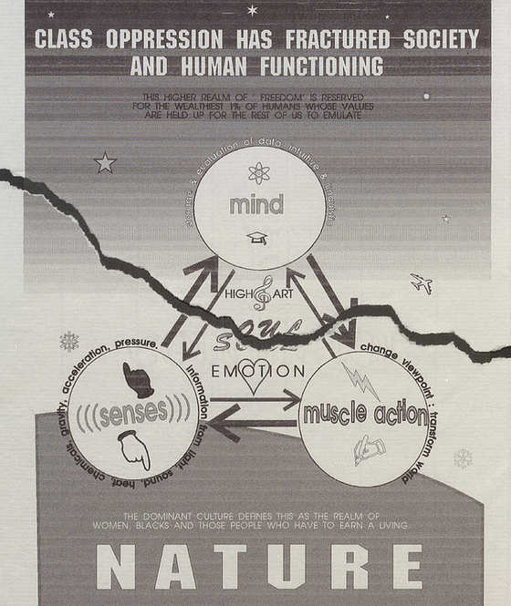
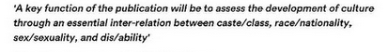
Notes:
Working Press

Slide 4
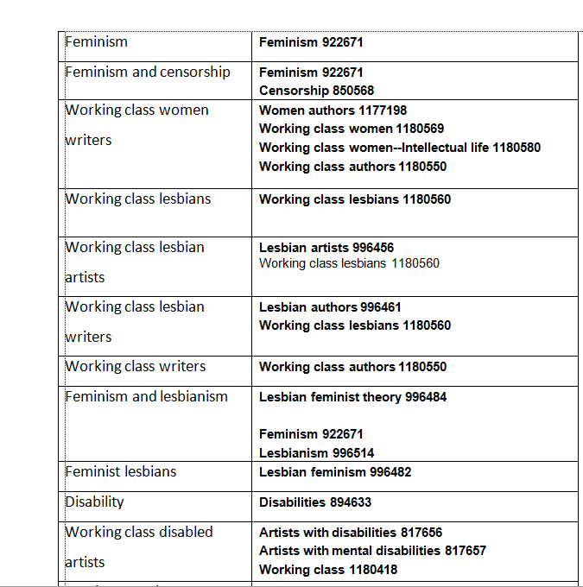
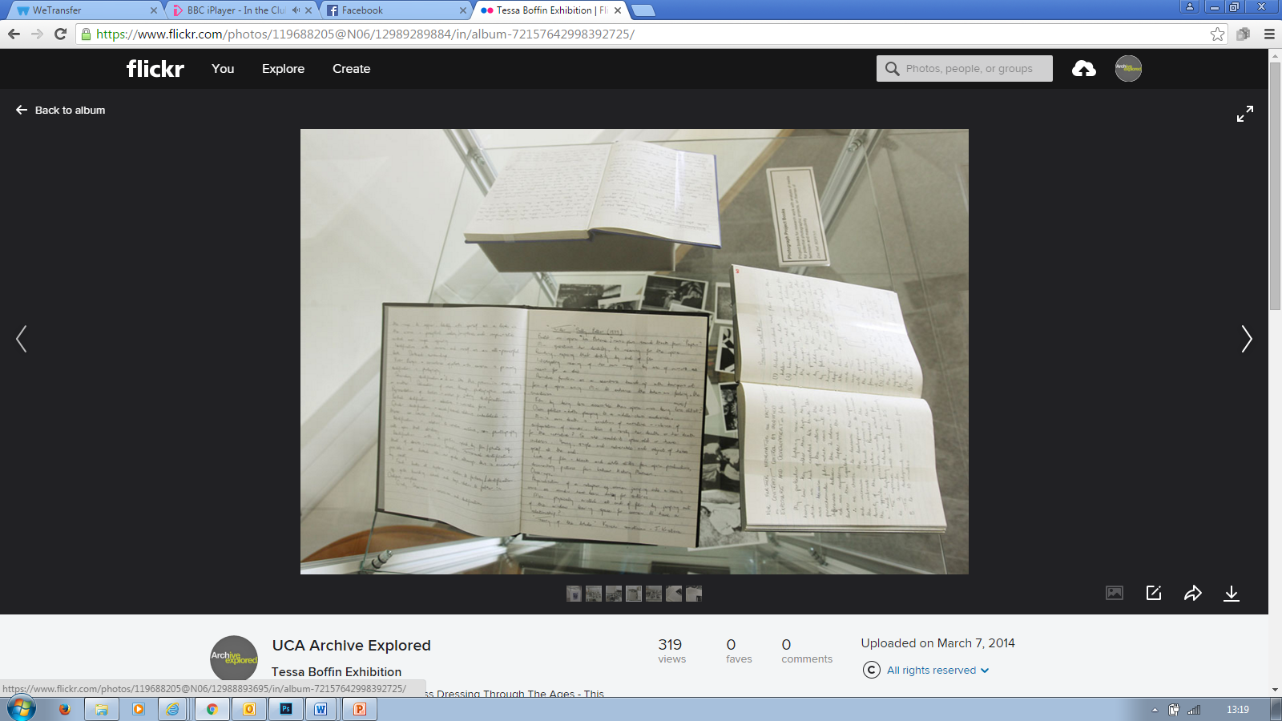
Notes:
Images of some of the records involved. Nicky’s search terms
This project initially involved
Selecting a sample of records from both collections relating to multiple identities- this was generally looking at item level records – as if looking at file levels keywords may be missed out that may be picked up only through Item level (picked one out at file level). I noted this as I had generally catalogued records down to file level – and from reviewing the records I selected, I didn’t include keywords I might have done if I had been listing at item level. I revisited these and looked at how I would keyword them. Number of records included 5 items, and 1 file, as I was interested in seeing whether participants would pick up the item/s I considered to demonstrate intersectionalities within.
Obviously I should note this is somewhat biased as I’m picking out material that I find particularly interesting on those levels.
Working Press, 1994 conference.
Orlan, the female body and the institution:
Working class lesbians- (fast OLCC – has working class lesbians)
Working class lesbian artists- (fast OLCC – does not have working class lesbians and artists)
Working class lesbians and censorship (does not have)
Female body
Performance art
Disease and art
Tessa Boffin Feminists against censorship letter
Feminism and LGBT history (links between)
Tessa Boffin notebook
Black sexuality
Black homosexuals
The photographic imagination – race, class, gender
Boff/5/1/6 article relating to Della Grace
Lesbian feminists
Gay men and sexism
Lesbians and sexism
BOFF/1/3/9
Stolen Glances lesbians take photography article
Next stages involved selecting controlled vocabulary to assess – this included OCLC http://www.oclc.org/research/themes/data-science/fast/download.html -faceted subject heading schema derived from the Library of Congress Subject Headings (LCSH). The purpose of adapting the LCSH with a simplified syntax to create FAST is to retain the very rich vocabulary of LCSH while making the schema easier to understand, control, apply, and use. The schema maintains upward compatibility with LCSH, and any valid set of LC subject headings can be converted to FAST headings.
(because based on library of congress terms used by library catalogue) and Unesco, The UNESCO Thesaurus is a controlled and structured list of terms used in subject analysis and retrieval of documents and publications in the fields of education, culture, natural sciences, social and human sciences, communication and informatio regarding suitability. This involved talking to the Data Quality Librarian, looking at how my terms best match across
UKAT Welcome to the website of the UK Archival Thesaurus (UKAT). UKAT is a subject thesaurus which has been created for the archive sector in the United Kingdom. It is a controlled vocabulary which archives can use when indexing their collections and catalogues.
The key aims of UKAT are: to improve access to archives by subject; to ensure that users of archives can carry out effective subject searches of the national archives network; and to promote the involvement in archives by groups which are under-represented among archive users, by providing subject terms which reflect their histories and experiences.

Slide 5
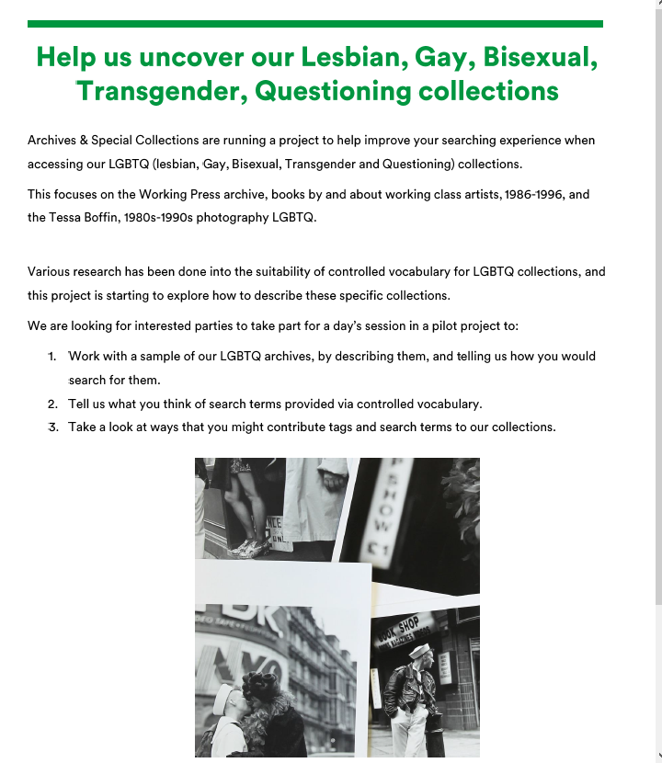
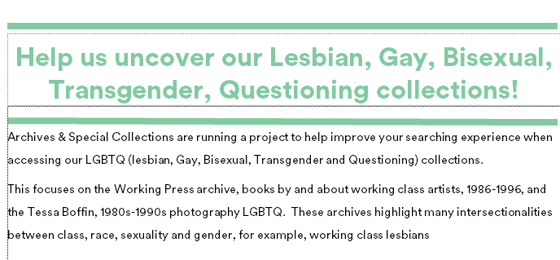
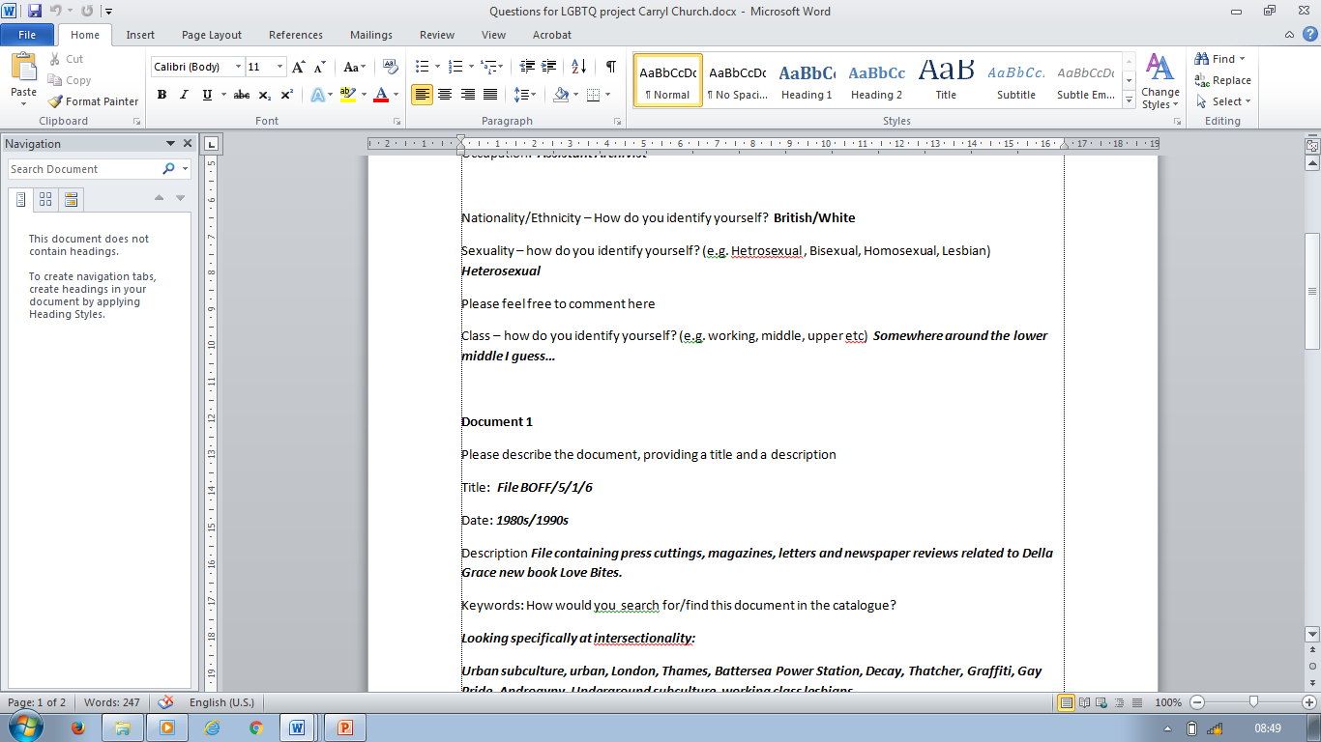
Notes:
I then created a call out for volunteers to help in a pilot project to tell us how they would search for these documents – this was and is open to internals and externals, and different communities, including students, staff, e.g academics with academics with interest in LGBT studies, including information professionals, LGBTQ communities, such as the LGBT plus group formed at uni. I also created a consent form to go with the questions (name being optional) relating to equality monitoring , including occupation and how they identified themselves class, sexuality wise, to see if that impacted on search terms given. Initially my call out didn’t mention that I was specifically looking at insectionalities, and multiple identities, with the first 2 participants as I was curious to see whether they would pick up on them themselves- however I changed this, as if of course this wasn’t something that was of personal interest/ in their experience this wouldn’t necessarily be picked up on.
The project involved explaining context around document, for example any unfamiliar political acts. They were then asked to write down terms they would used to find the document or describe it, in regards to their own personal interests, or in terms in experience related to their occupation.
I then introduced them to controlled vocabulary and asked them to let me know what they thought in their experience

Slide 6
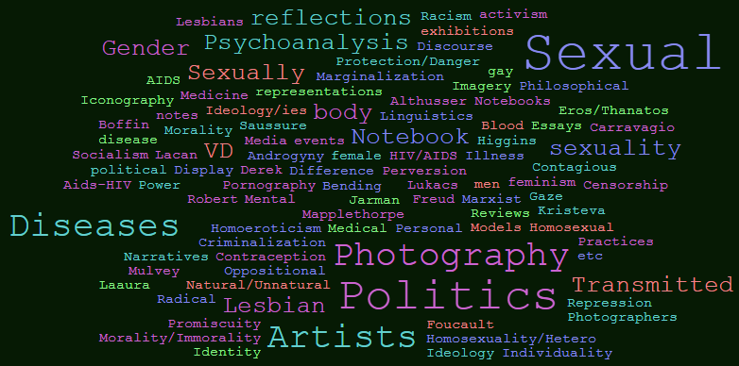
Notes:
Thoughts on controlled vocab – some
Some results from pilot study. Just note sample so far are students and Informational professionals.– 3 students, 4 staff librarians, archivist, library manager. Need to extend this.
(email Tom – ask to complete this)
Images of some of the documents – search terms (word cloud)
Choose Notebook
Look at file
quotes.

Slide 7
I found it difficult to read this review dispassionately. I was aware I was wanting to put in terms that were really subjective that expressed my feelings about it such as, Psychotic, Disturbed, Pointless and Idiot
My initial response is that I really like the Unesco Thesaurus. I think that showing the hierarchies is very useful when you are deciding what to use, as the broad term/narrower term relationship works for me. Oclc has ease of use as a ‘selling point’, and also I appreciate the way that you can get taken through to publications
Searchfast gave me an answer to ‘LGBTQ’ while the others were non-plussed. Searchfast also seemed more helpful generally. Perhaps it’s because it relates to LCSH [library of congress], which is my background.
Definitely in the Searchfast camp. It seems more at home with current terminology. I actually have issues with current terminology in that it seems to multiply by the second in a seemingly undisciplined way and be based more in politics that logic
Notes:
Thoughts on
Thoughts on controlled vocab – some answers

Slide 8
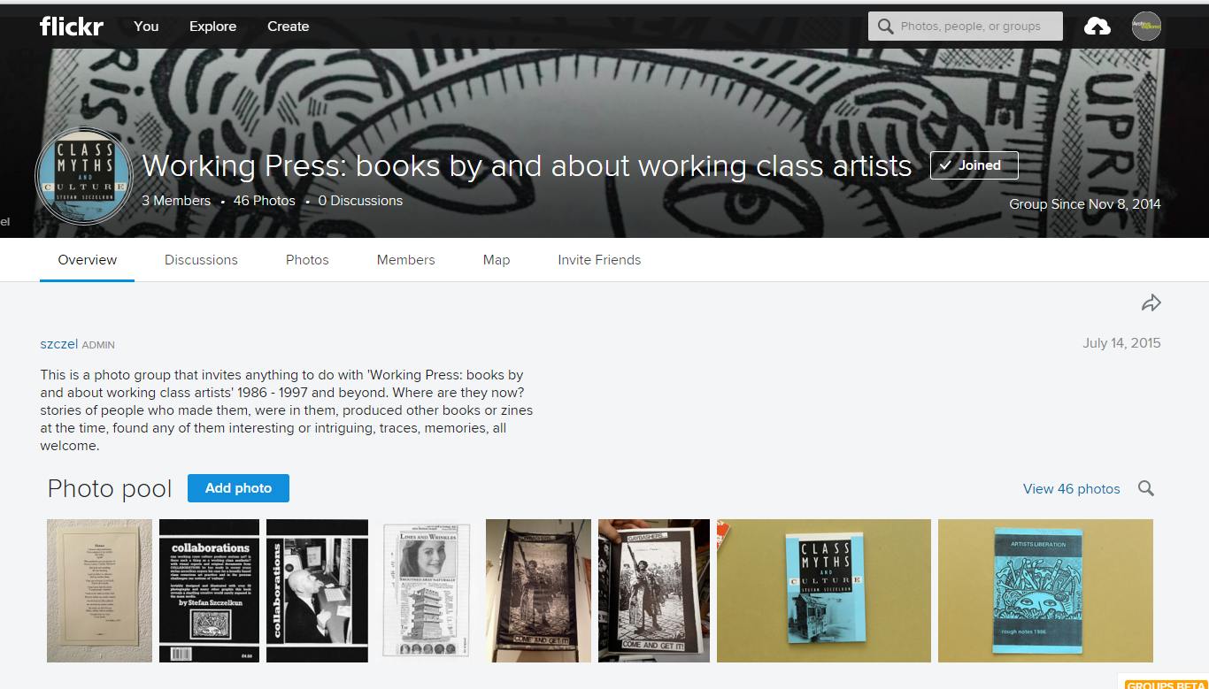
Engaging with communities digitally
Notes:
Flickr account. Engaging with communities There are obviously issues when you don’t know intent – writers can help with this.
Metadata games

Slide 9
Next steps/thoughts
Difficulties with reviewing documents ‘dispassionately’
Need to engage further with different groups/engage further with controlled vocab
More Product, Less Process?

Slide 10
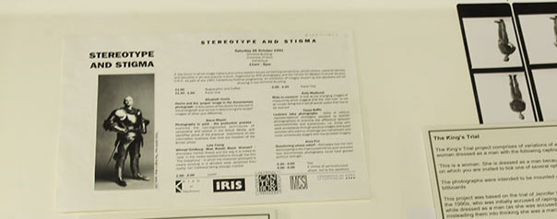
Interested in participating? Email archives@ucreative.ac.uk

