Slide 1
HEA Arts & Humanities conference workshop
Annamarie McKie – Educational Developer – amckie@uca.ac.uk
Maria Tannant – PM in Digital Pedagogy – mtannant@uca.ac.uk
University for the Creative Arts

Slide 2
ONE STEP BEYOND:
exploring assessment for learning
in the creative arts

Slide 3
Session outline
Assessment and feedback challenges in art and design
UCA student experiences of assessment and feedback
Conditions assessment supports student learning
Models of assessment for assessing creative work
UCA approaches to assessment and feedback.
Notes:
Working in groups, this interactive workshop will explore alternative methods of assessment through scenario-based discussion with the aim of illuminating the many challenges and tensions of assessment practice. The core aims will be as follows:

Slide 4
What are the challenges with assessment and feedback in
art and design?
Notes:
Icebreaker group discussion

Slide 5
Assessment and feedback in art and design
‘There remains varied interpretations and understandings, held by students and academics, on what is feedback, how feedback is defined and how this can inform learning’. (Blair, 2009)

Slide 6
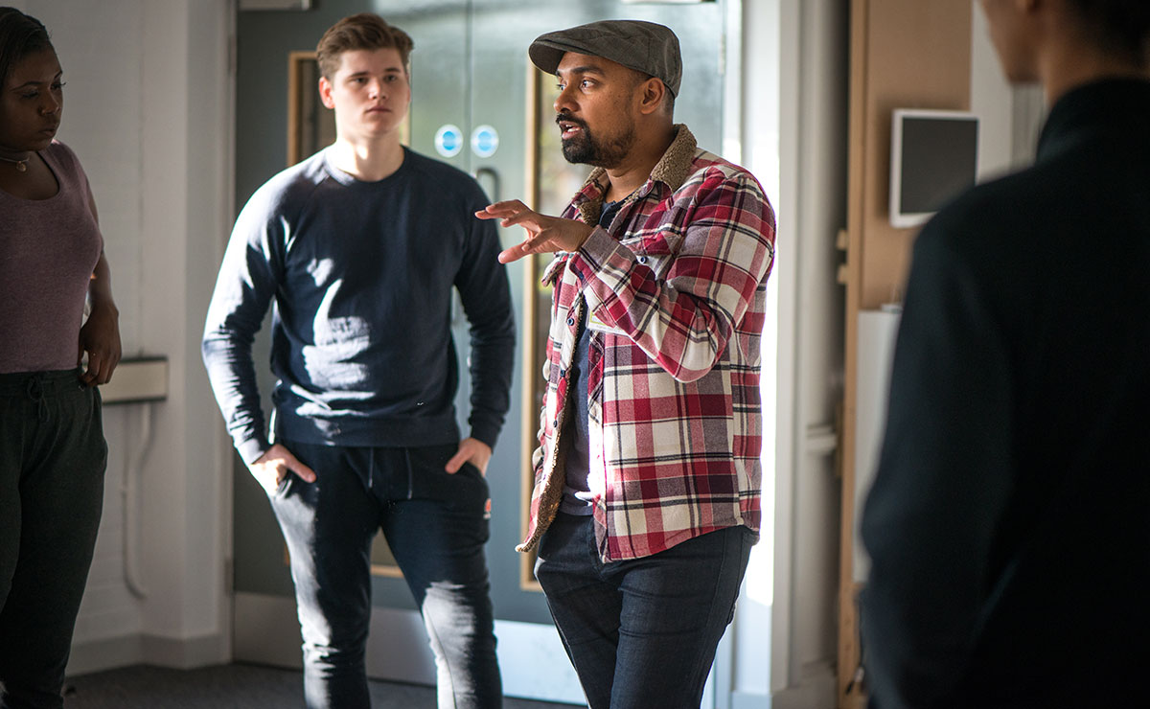
Assessment and feedback challenges at UCA
Notes:
Qualitative feedback comments…
not enough tutor time… grade obsessed… high achievers… comparing marks… subjectivity…school based literacies…assessment of learning
NSS research – students not making the most of tutorials and describing troublesome experiences of feedback, i.e. difficult crits, students not making the most of their formative feedback – all seen to rest on tutor

Slide 7

Assessment and feedback challenges at UCA
‘Feedback can be somewhat vague at times. You need to ask questions further to clarify’
‘My tutors sometimes
give contradictory feedback. This can be useful to help you develop your own view on what may or may not work, rather than relying on theirs. For some, this is also confusing.’
Notes:
Students are saying

Slide 8
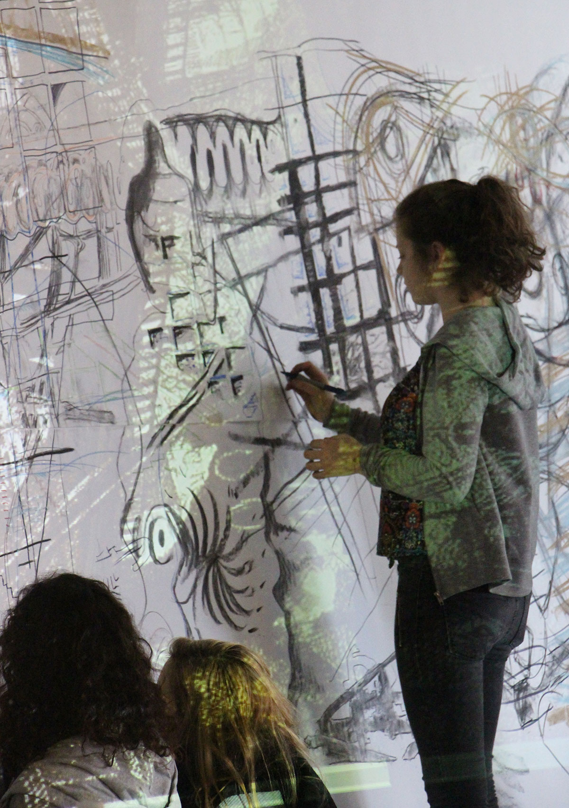
Assessment and feedback challenges at UCA
‘Our tutor will say
great, love it and then two weeks later in another formative review, another tutor says scrap it…I am really confused now and don’t know how to develop my work…’
Notes:
Students are saying
(UCA student, March 2013 ‘What’s behind the NSS’ research)

Slide 9
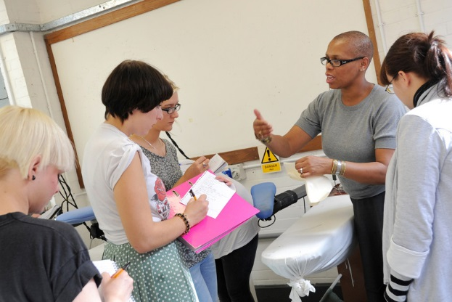
What conditions are needed for assessment to
support student learning?
Notes:
Group discussion and flipchart exercise
Graham Gibbs handout – deconstruct statements in pairs? Or perhaps we should give this out at the end?

Slide 10
Assessment and feedback scenarios in art and design
10 minutes to discuss and 5 minutes to present idea
http://padlet.com/mariatannant/scenario1
http://padlet.com/mariatannant/scenario2
http://padlet.com/mariatannant/scenario3
Notes:
Split into three groups – 10 minutes to discuss and 5 minutes to present ideas on -
Scenario 1 (High performing fashion course – but students unhappy about assessment and feedback, despite course team spending time writing up feedback, students unhappy about their grades and do not understand how their work was assessed);
Scenario 2 (Acting and Performance course – new course with strong philosophy of student centred approaches, students have been encouraged to self assess and use peer assessment techniques – some students have disagreed with their grades; how can this be avoided?
Scenario 3 (Craft based course with small student numbers – staff spending a lot of time with students giving formative feedback at the development stage, however, students are unhappy with their assessment and feedback experiences – how could their experience be improved?

Slide 11
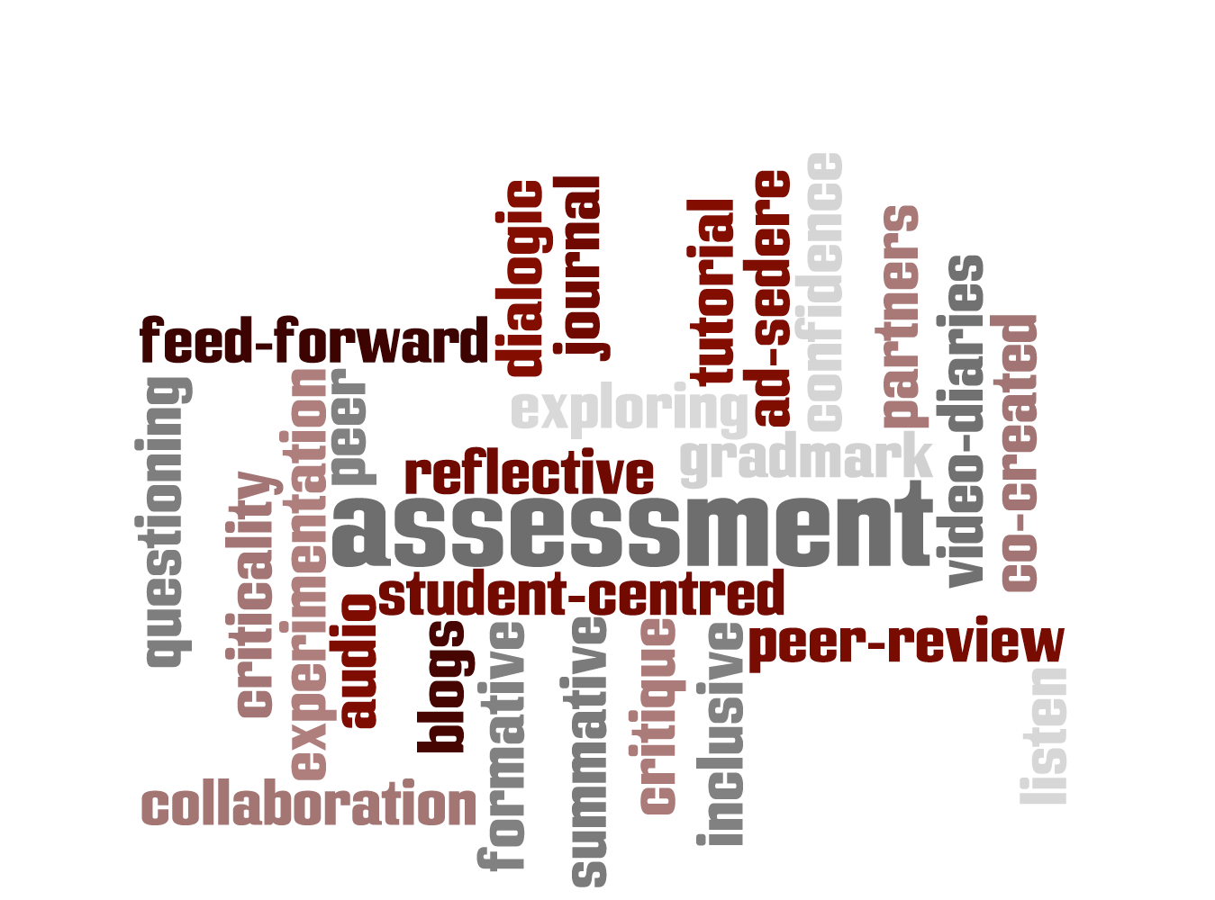
Alternative Assessments
Notes:
Give out Leadership Foundation handout
Formative assessment
Peer assessment
Self assessment
Online assessment
Formative and summative assessment? Assessment and feedback policy
Alternative Forms of Assessment & points previously agreed (being creative with assessment tasks and how do you mark them)
i. Need a broader take on assessment tasks (more inclusive assessment?)
ii. Cultural shift from ‘assessment of learning’ to ‘assessment for learning’
iii. Move away from atelier models (master/apprentice) to a more dialogic model of feedback
iv. Group need to be challenged a bit, to incorporate more inclusive approaches/alternative assessment and feedback
v. Assessing the learning (not the work)
vi. Feeding-forward (not feed back)

Slide 12
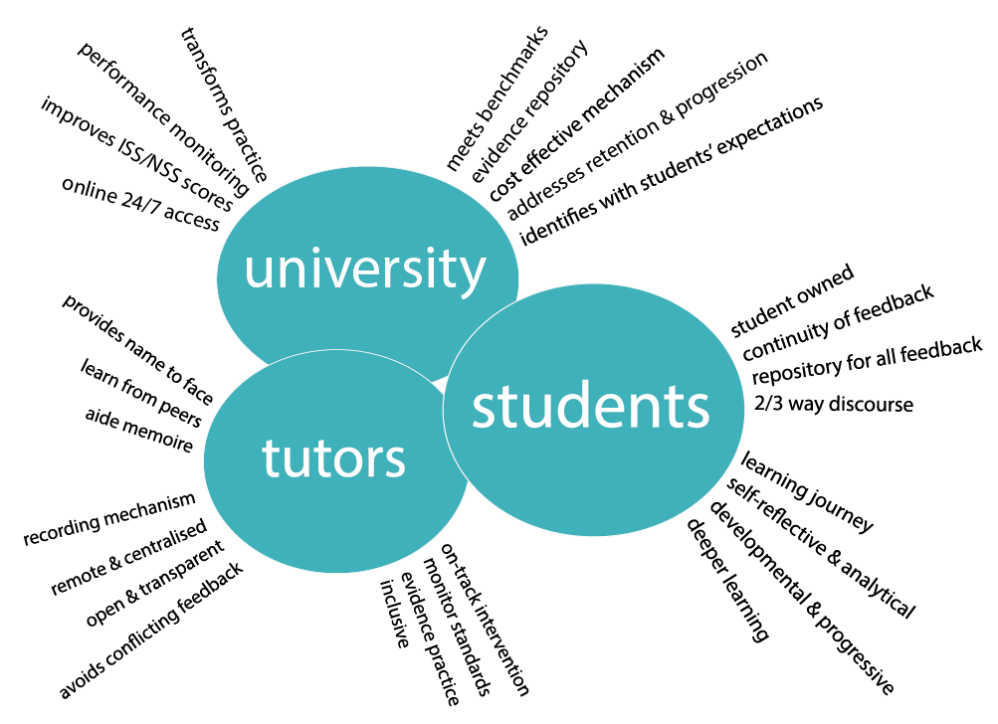
Flexible assessment and feedback methods
using technology
Notes:
Examples of online assessment and feedback methods
Audio feedback, online assessment, my feedback

Slide 13
Bibliography
Barrow, M. (2006). Assessment and student transformation: linking character and intellect. Studies in Higher Education, 31(3), pp.357-372.
Bourdieu, P. (1977). Outline of a Theory of Practice. Cambridge, Cambridge University Press.
Bourdieu, P. (1986). Distinction: A Social Critique of the Judgement of Taste. London, Routledge.
Cannatella, H. (2001). Art Assessment. Assessment and Evaluation in Higher Education, 26(4), pp.319-326
Cowdroy, R., & deGraff, E. (2005). Assessing highly-creative ability. Assessment and Evaluation in Higher Education, 30(5), pp.507-518.
Cresswell, M. (1996). Defining, setting and maintaining standards in curriculum-embedded examinations: judgmental and statistical approaches. In H. Goldstein & T. Lewis (Eds.), Assessment: problems, developments and statistical issues (pp. 57-84). Chichester, Wiley.
Gordon, J. (2004). The 'wow' factors: the assessment of practical media and creative arts subjects. Art, Design and Communication in Higher Education, 3(1), pp.61-72.
Orr, S. (2005). ‘Justify 66 to me!’ An investigation into the social practice of agreeing marks in an HE art and design department. In C. Rust (Ed.), Improving Student Learning through Assessment: Proceedings of the 13th International Symposium (pp. 283-294). London, Oxford Brookes University.
Orr, S. (2007). Assessment Moderation: Constructing the Marks and Constructing the Students. Assessment and Evaluation in Higher Education. 32(6), pp.1-12.
Orr, S. (2010) The Role of Professional Judgement in Assessment: A Journey from Accuracy to Zing. Inaugural Professorial Lecture. York St John University. January 2010
Orr, S. (forthcoming) ‘We kind of try to merge our own experience with the objectivity of the criteria’: The role of connoisseurship and tacit practice in undergraduate fine art assessment, Art, Design and Communication in Higher Education.
Percy, C. (2004). Critical absence versus critical engagement. problematics of the crit in design learning and teaching. Art, Design and Communication in Higher Education, 2(3), pp.143-154.
Price, M. (2005). Assessment standards: the role of communities of practice and the scholarship of assessment. Assessment and Evaluation in Higher Education, 30(3), pp.215-230.
Rowntree, D. (1987). Assessing Students: How shall we know them? London, Kogan Page Limited.
Shay, S. (2003). The assessment of final year projects: a study in academic professional judgment. PhD Dissertation. Unpublished manuscript, University of Cape Town. South Africa.
Shay, S. (2005). The assessment of complex tasks: a double reading. Studies in Higher Education, 30(6), pp.663-679.
Snyder, B. R. (1973). The Hidden Curriculum. Boston: MIT Press.
Wenger, E. (2004). Communities of Practice: Learning, Meaning and Identity. Cambridge, Cambridge University Press.
Yorke, M., Bridges, P., & Woolf, H. (2000). Mark distributions and marking practices in UK higher education. Active Learning in Higher Education, 1(1), pp.7-27.

