Slide 1
Tackling first year student engagement with learning technologies and the VLE
Notes:
Just when you think everything is running smoothly,
You get a jolt of reality!
Who exactly is using the VLE and on what device

Slide 2

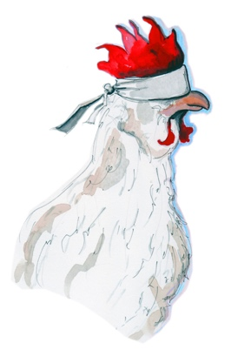
All eggs in one basket…
or just blindfold the chicken?

Slide 3

The ideal… all eggs in one basket
Notes:
In an ideal world how great it would be to simply access all the valuable learning technologies from one place…
Namely the VLE
But we know this is far from possible.

Slide 4
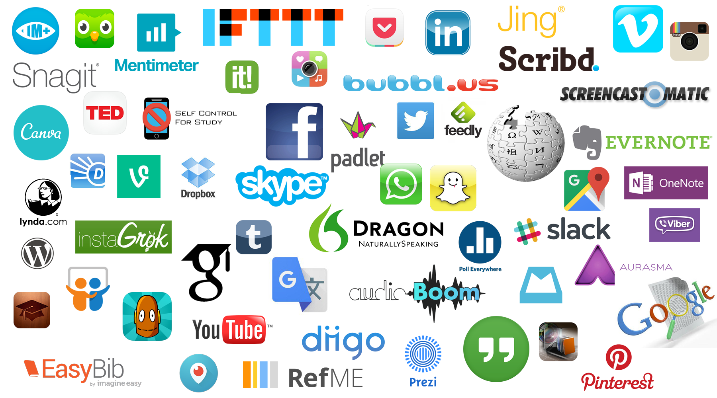
Scattered tools & resources used outside the VLE
Notes:
- Tools that students and staff use outside of the VLE
- The ideal of a ‘central learning environment’ cannot be achieved anymore
- Like a pick and mix sweet shop, there’s a host of solutions
- Not everything is listed here, but these tools represent alternatives
- Catering for different learning styles
- A host of methods around digital curation… and digital literacy via resources and interaction
- These tools can offer greater flexibility and user experience for learning & teaching

Slide 5
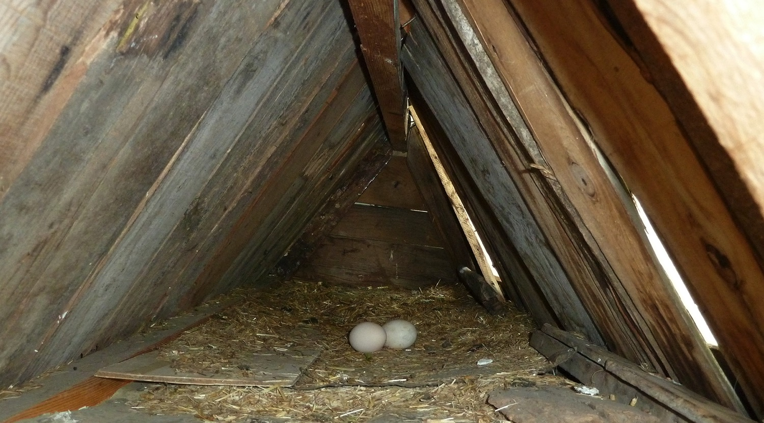
what’s left in the VLE?
Notes:
So after looking at the MASS of tools available externally, what exactly is left in the VLE?
How important and valuable are they to student learning?

Slide 6
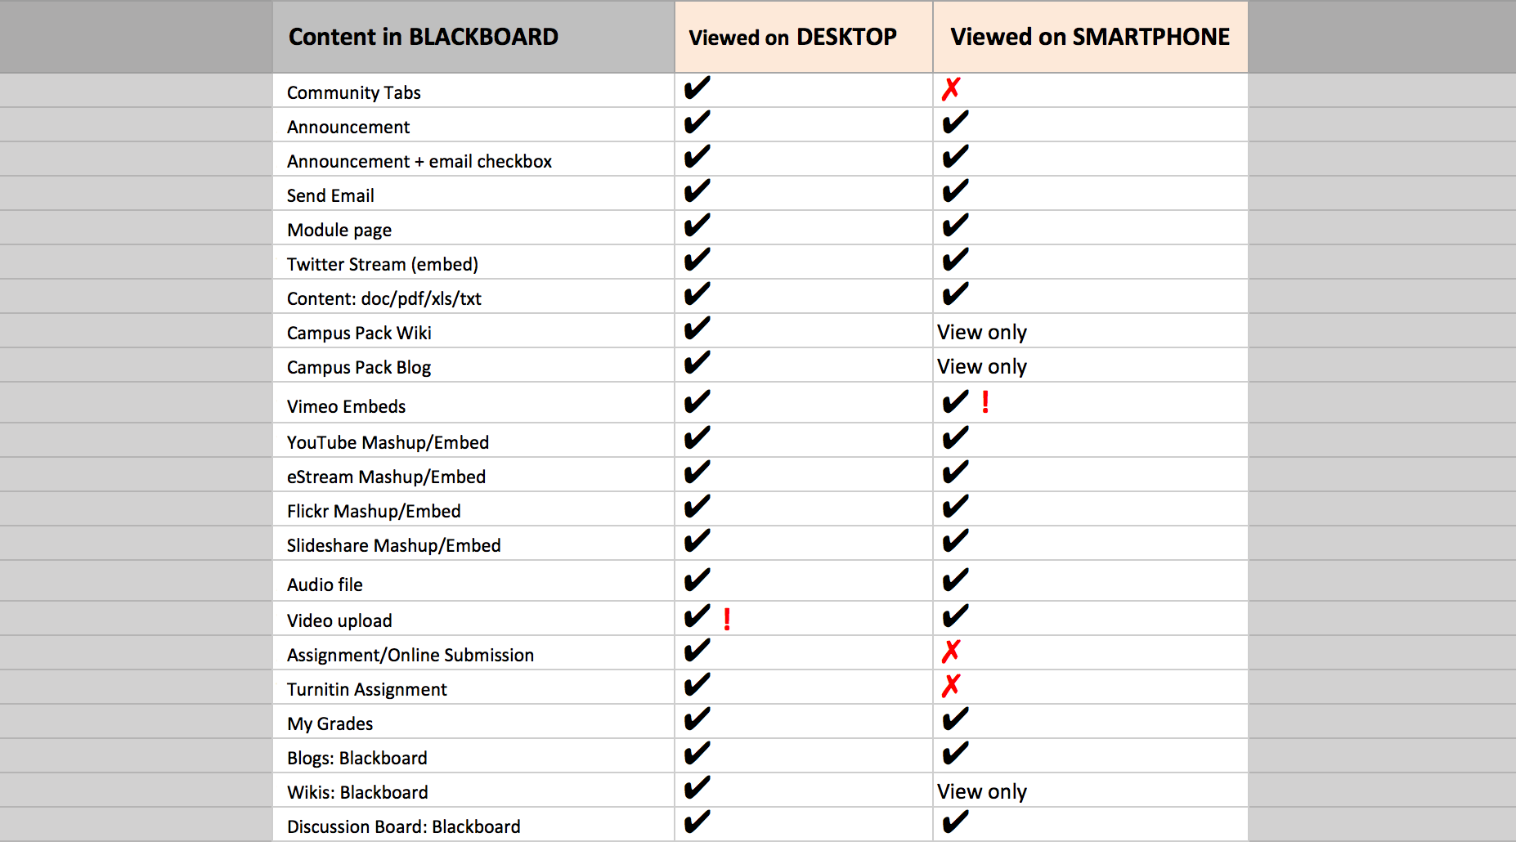
Default tools & resources in VLE
Notes:
Regular tools that work in Blackboard Learn
After extensive testing here’s what I found worked on mobile and desktop devices

Slide 7
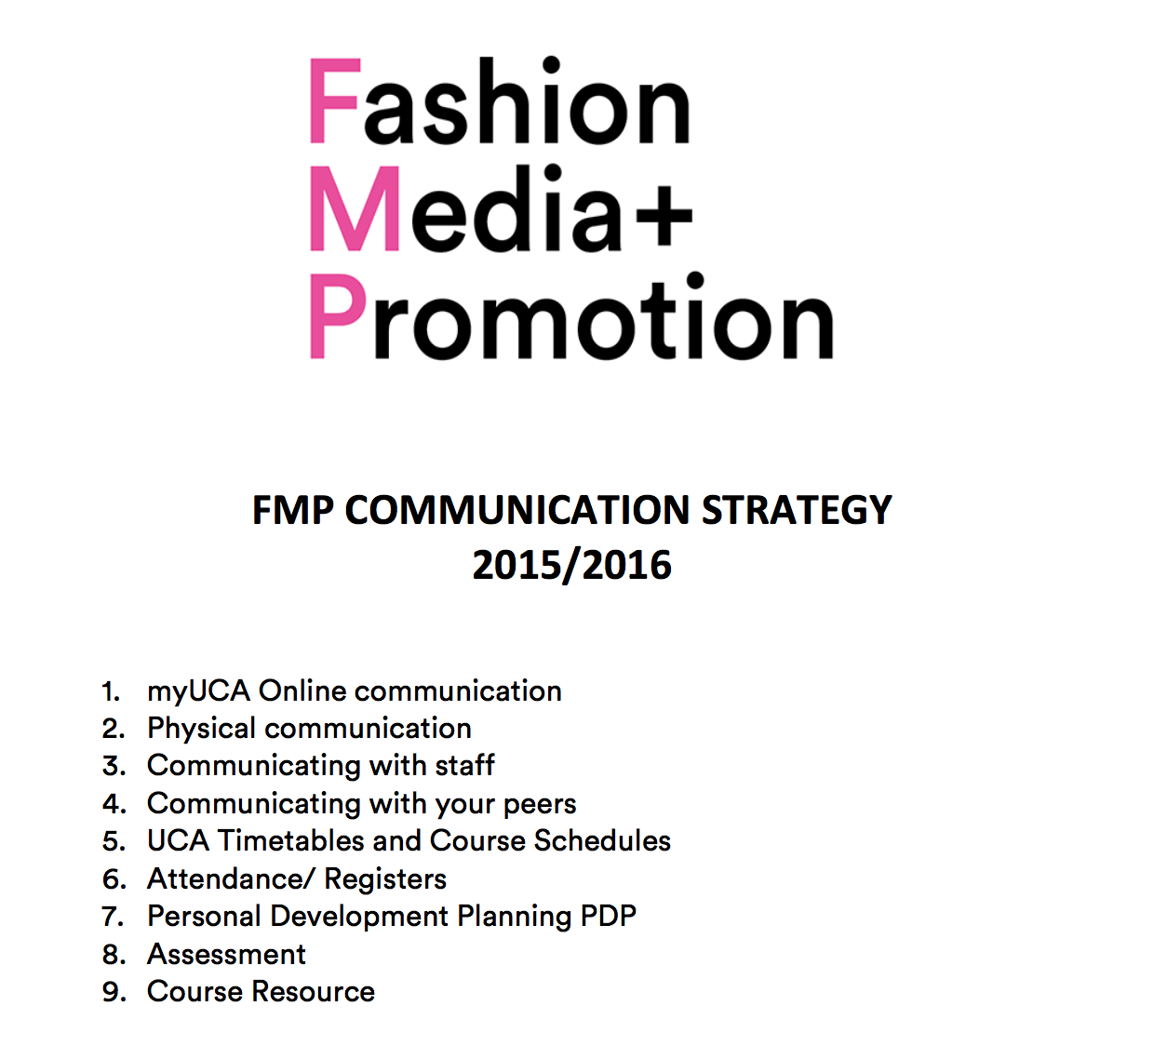
Students sampled for usage
Notes:
This ‘difference’ means we need to carefully consider what kind of TEL learning experience our students will have.
This course make it very clear to students how everyone is expected to communicate and what tools/platforms/resources they are to use throughout their time at Uni.
This includes social media such as LinkedIn, Twitter, Instagram and Pinterest.
However, the document does not cover the full extend of teaching and learning methods together with subject specific university resources.
So perhaps writing a T&L Strategy is the next task for the course team

Slide 8
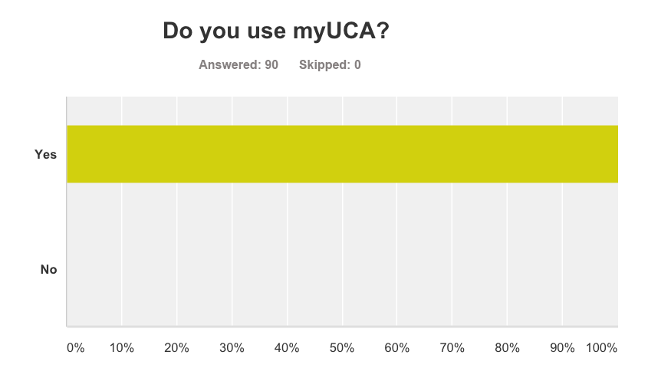
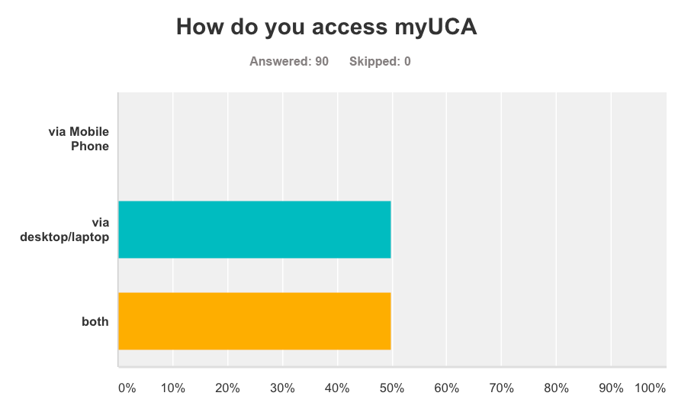
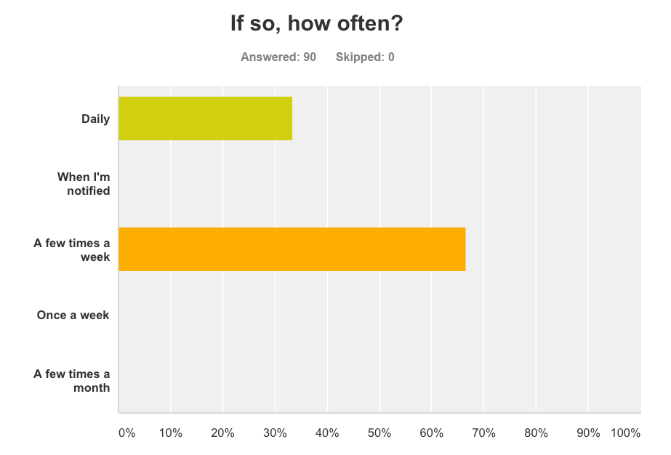
Students sampled for VLE usage
Notes:
Hence, their usage of the VLE is well rounded and smartphones are employed to mainly receive updates and notifications
Whereas laptops are employed for deeper study and the production of work
But this course’s adoption of the VLE is not mirrored across the university
Where there is contrasting uses of technology and processes
So perhaps we should be thinking more about exploiting the use of intuitive learning tools

Slide 9
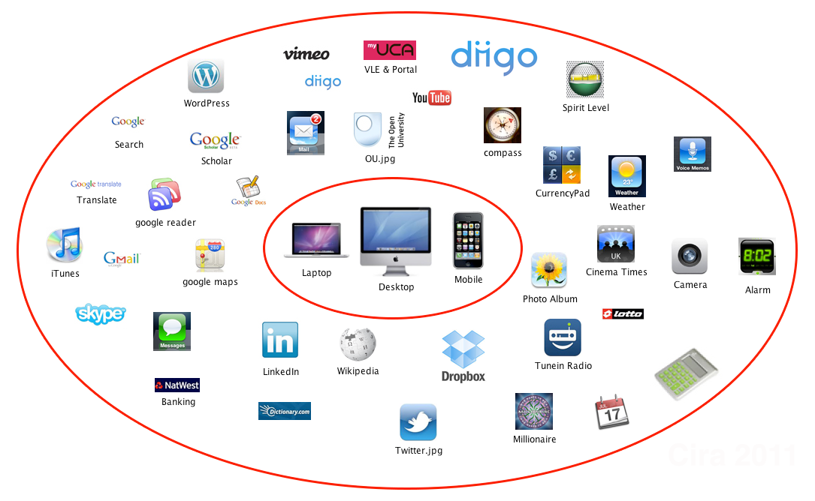
PLEs are systems that help learners take control and
manage their own learning (Harmelen 2008)
Notes:
- I made this Personal Learning Environment (PLE) while studying MAODE in 2011
- This was my own interpretation of the tools I used to enhance my learning
- But more importantly… how I organised my learning
- Getting onboard with Dropbox was the single biggest achievement to manage my study & work files
References
(1) Van Harmelen, H. (2008). "Design trajectories: four experiments in PLE implementation". Interactive Learning Environments 16 (1): 36 – 46.
http://www.tandfonline.com/doi/pdf/10.1080/10494820701772686

Slide 10
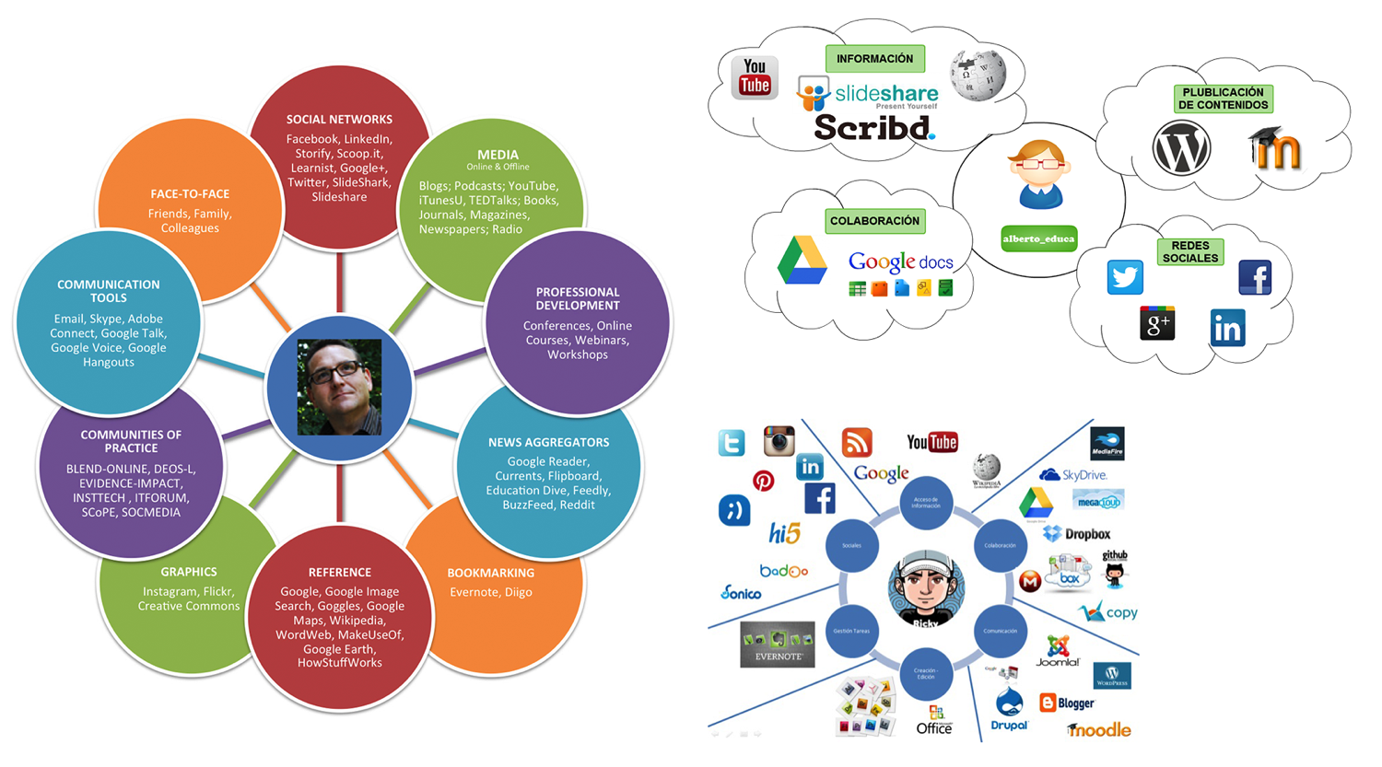
Diversity and usefulness
Notes:
PLEs have different meanings and values to people
Specific tools have different uses depending on the user
The concept of being digitally organized has a large role to play for learners

Slide 11
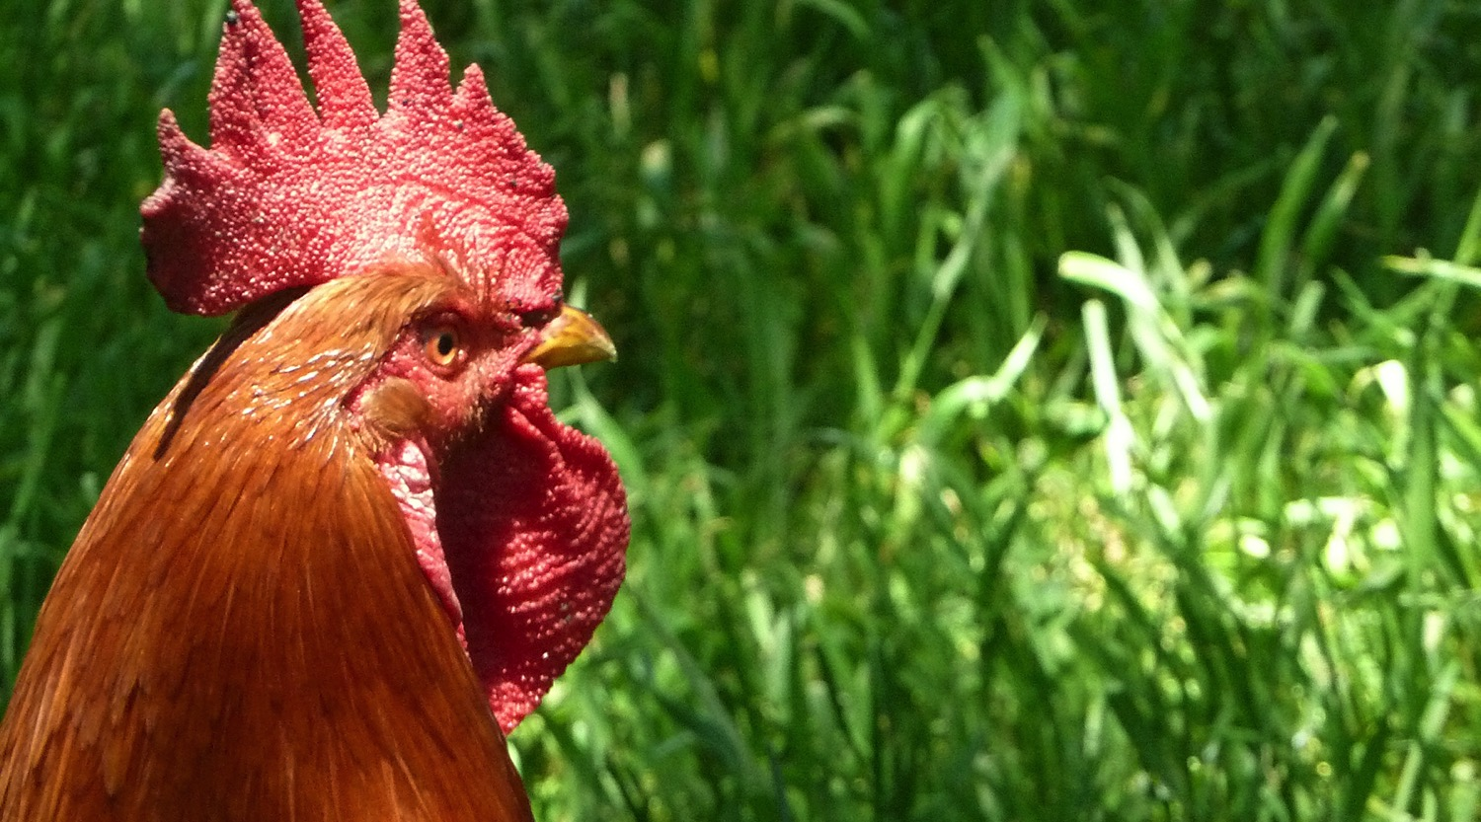
So who is the blindfolded chicken?
Notes:
We could view the maverick tutor going astray and doing his/her own thing with TEL
And not bothering about adding to the basket of eggs in the VLE
The student could be viewed as the blindfolded chicken getting lost in the plethora of new technologies

Slide 12
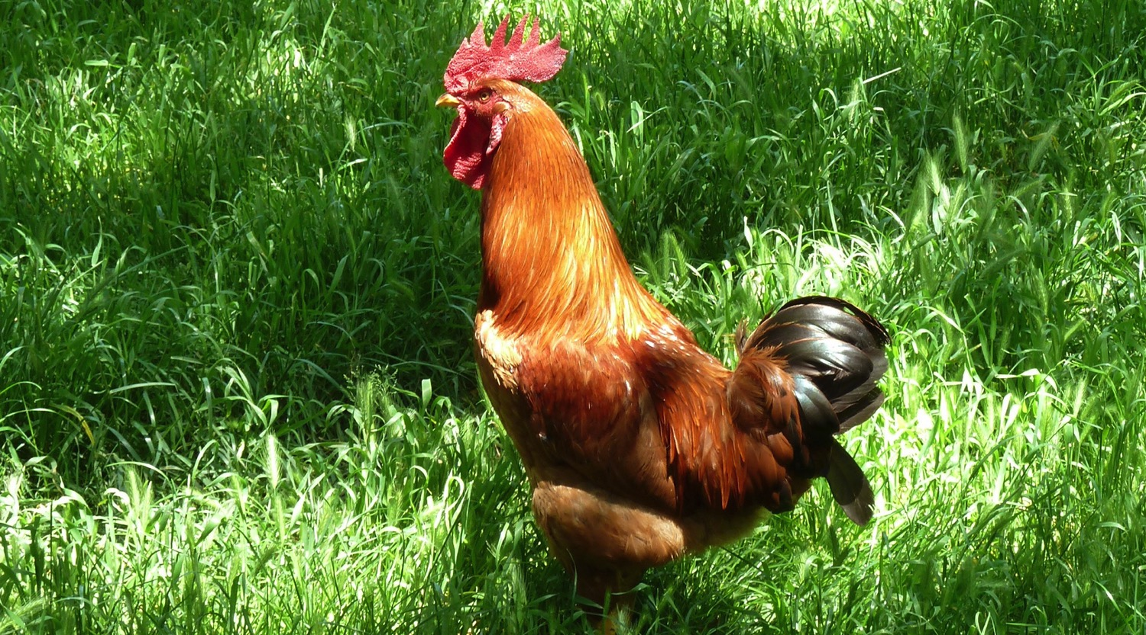
Is free-range any better?
Notes:
The notion of new and innovative pedagogies may well emerge from a less restricted approach

Slide 13

Group Task 1
The Perfect PLE - 10 minutes
Design a PLE to most enhance a new student's
learning experience at university. The group may
elect a specific subject area the student has
chosen to study.

Slide 14
Group Task 2
TEL Manifesto - 10 minutes
Draft up an institutional TEL Manifesto intended
for new students that enhances learning and
enriches their online user experience.

Slide 15
Group Workspaces
Group 1: http://padlet.com/mariatannant/BB1
Group 2: http://padlet.com/mariatannant/BB2
Group 3: http://padlet.com/mariatannant/BB3

Slide 16
MARIA TANNANT
Programme Manager in Digital Pedagogy
mtannant@uca.ac.uk
References
Van Harmelen, H. (2008). "Design trajectories: four experiments in PLE implementation". Interactive Learning
Environments 16 (1): 36 – 46.

