Slide 1
Zwarte Piet Trilogy
Anna Fox

Slide 2
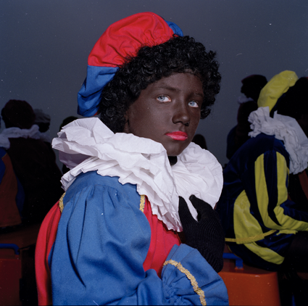
Notes:
Performative space between the subject and the photographer

Slide 3
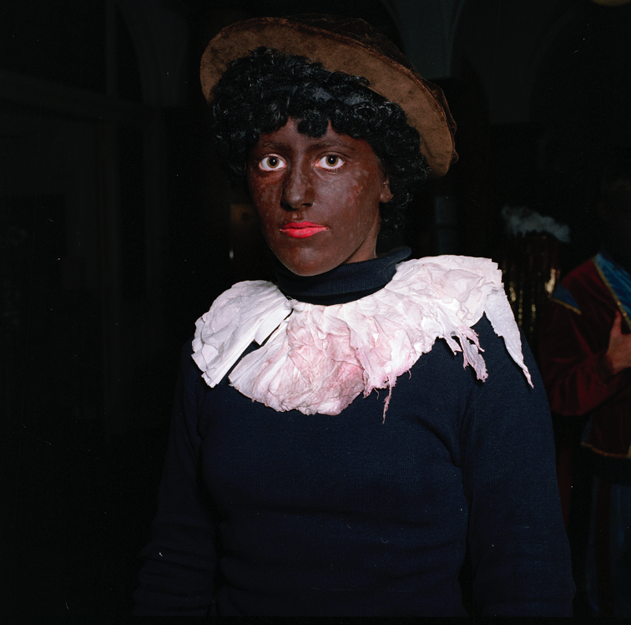

Slide 4
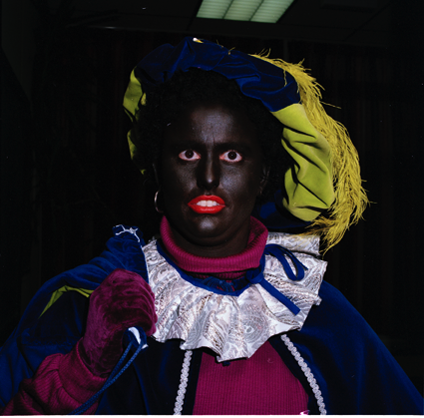

Slide 5
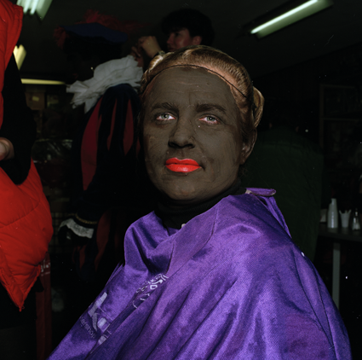

Slide 6
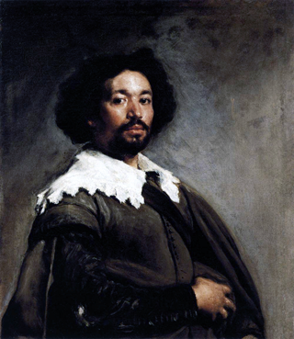
Notes:
Juan de parreja - velasquez
Where do ideas come from

Slide 7
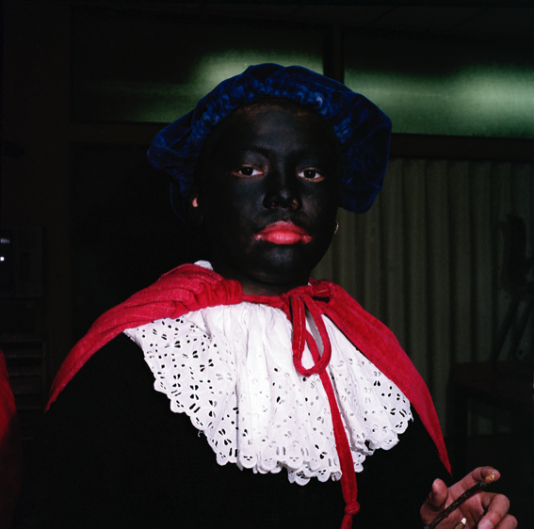
Notes:
At home
And abroad
Ordinary everyday

Slide 8
Notes:
At home
And abroad
Ordinary everyday

Slide 9
Notes:
At home
And abroad
Ordinary everyday

Slide 10
Notes:
At home
And abroad
Ordinary everyday

Slide 11
Notes:
At home
And abroad
Ordinary everyday

Slide 12
Notes:
At home
And abroad
Ordinary everyday

Slide 13
Notes:
At home
And abroad
Ordinary everyday

Slide 14
Notes:
At home
And abroad
Ordinary everyday

Slide 15
Notes:
At home
And abroad
Ordinary everyday

Slide 16
Notes:
At home
And abroad
Ordinary everyday

Slide 17
Notes:
At home
And abroad
Ordinary everyday

Slide 18
Notes:
At home
And abroad
Ordinary everyday

Slide 19
Notes:
At home
And abroad
Ordinary everyday

Slide 20
Notes:
At home
And abroad
Ordinary everyday

Slide 21
Notes:
At home
And abroad
Ordinary everyday

Slide 22
Notes:
At home
And abroad
Ordinary everyday

Slide 23
Notes:
At home
And abroad
Ordinary everyday

